Slide 1
Uda for Steel tube detection
BLM Group - University of Trento

Slide 2
layout
Objective of the project
Overview of object detection framework
Synthetic dataset generation
Methodology
Result and Discussion
Objective
Overview
Generation
Methodology
Result

Slide 3
Objective of the Project
Developing the steel tube detection system
Synthetic dataset generation
Unsupervised domain adaptation (UDA) module
Training and testing the UDA module for object detection framework
Objective
Developing the steel tube detection system
Unsupervised domain adaptation (UDA) module
Training and testing the UDA module

Slide 4
Review: Object detection
Two-Stage
Single-stage
Generate region proposals; draw candidates of objects (ROI)
2nd computes features from each candidate region
final stage is a fully connected layer
Higher detection accuracy, longer inference, more complex training processes.
R-CNN, Fast-RCNN, Faster-RCNN,
Process by directly predicting object bounding boxes and class labels in a single forward pass.
Simple training process, fast, and moderate
Anchor based one-stage methods encompass YOLO and its successors,
Anchor free one-stage FCOS

Slide 5
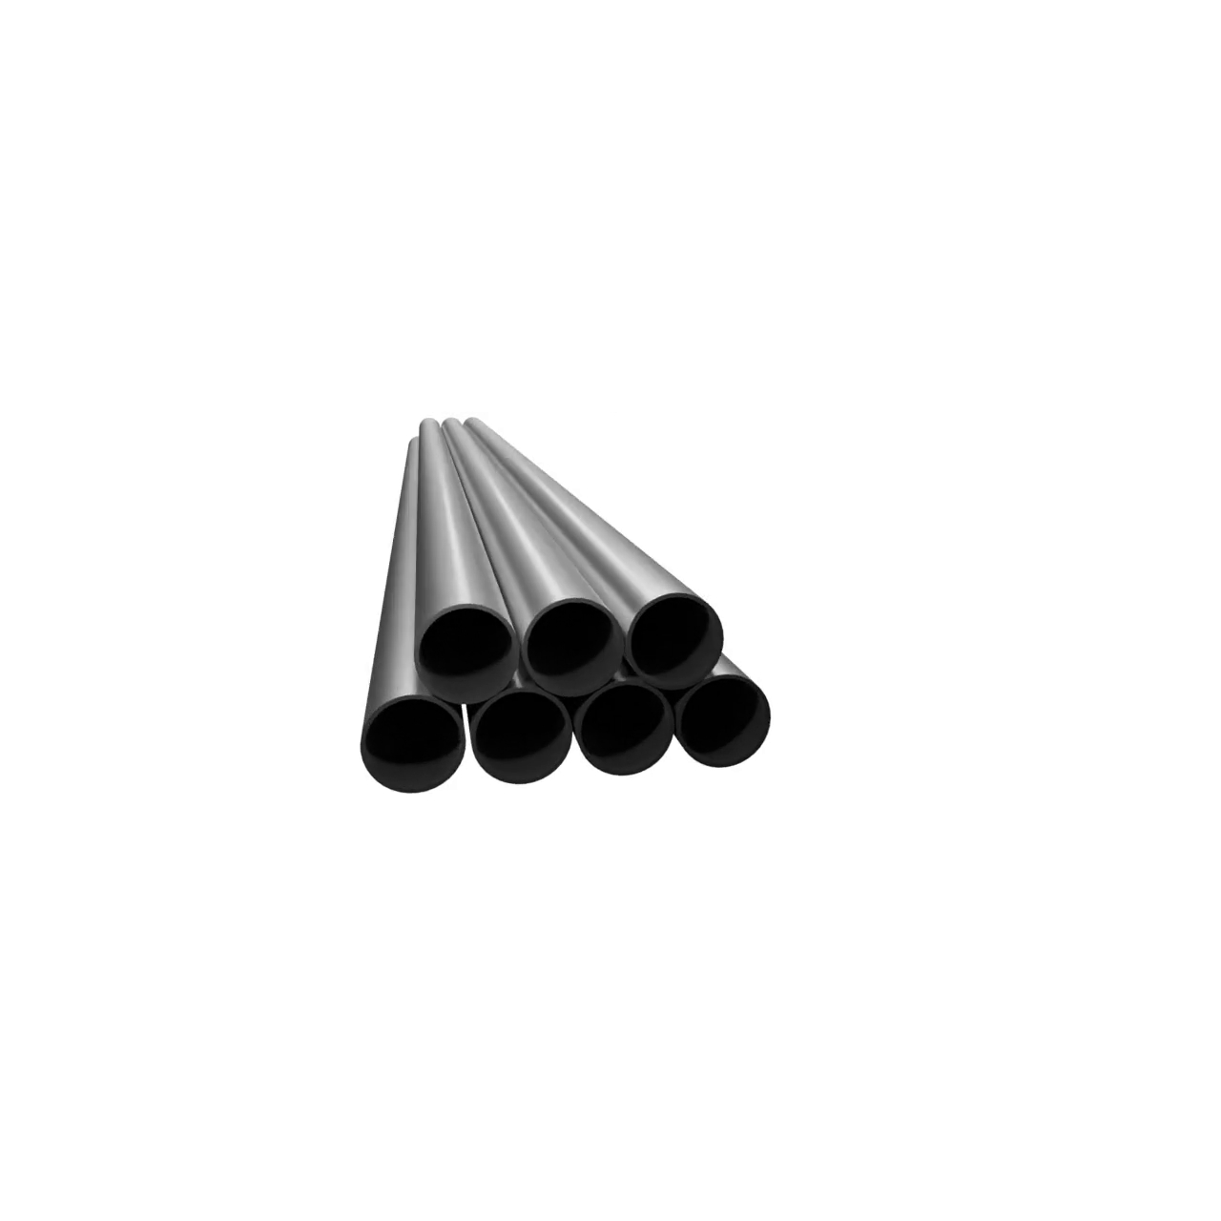
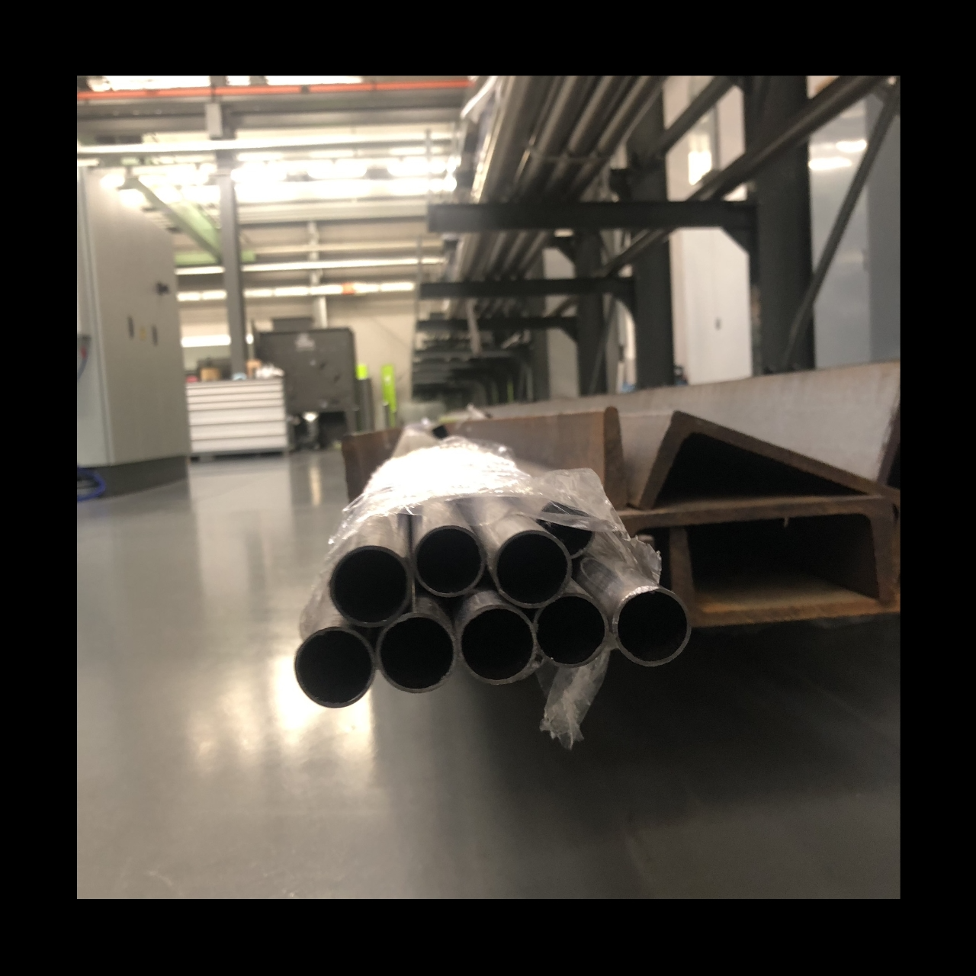
Blender Python API
The three major steps to generate synthetic dataset on Blender using Python API.
Creating object and material
Formulating three-point lighting mechanism
Developing Bezier circle and camera and sync them

Slide 6
Synthetic dataset generation
3D CAD model is created on SolidWork, and saved in .stl file format.
Importing the .stl file format of the 3D CAD model in to scene creating format of the Blender
Locating and setting up the orientation of the imported .stl CAD file
Setting-up the camera and the Bezier Circle and attach them in the way path to follow for the camera.

Slide 7
Cont.
Creating the material which mimic steel tube profile,
The material just created or already existed can be append to the 3D CAD file in the scene of the Blender.
Rendering animation and generate the video file;
Subsequently annotating the video file using semi-annotating software (github repository).
Finally, the process produce a single .txt file of the video per fps.

Slide 8
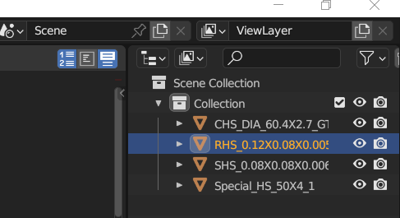
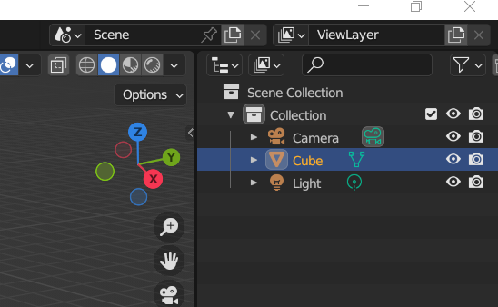
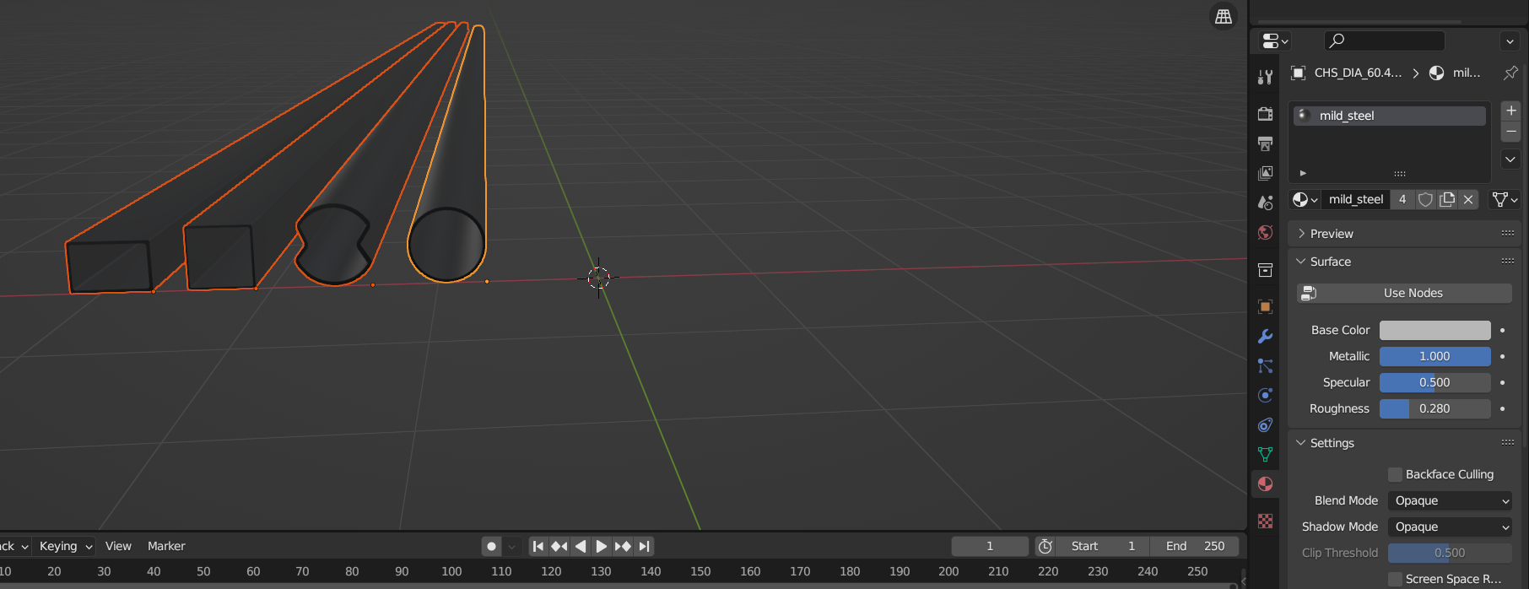
Scene visualization

Slide 9
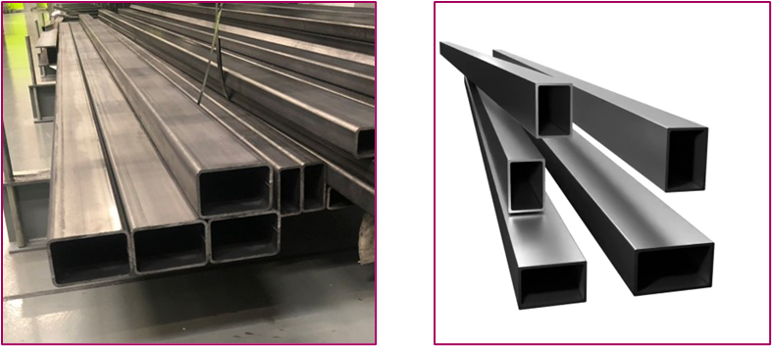
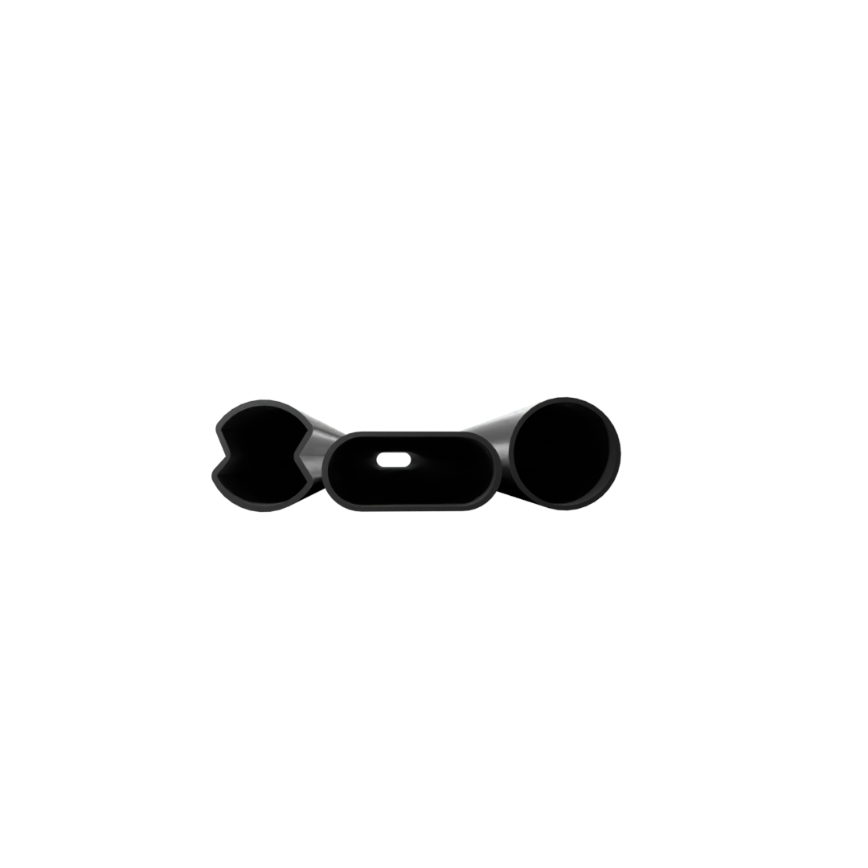
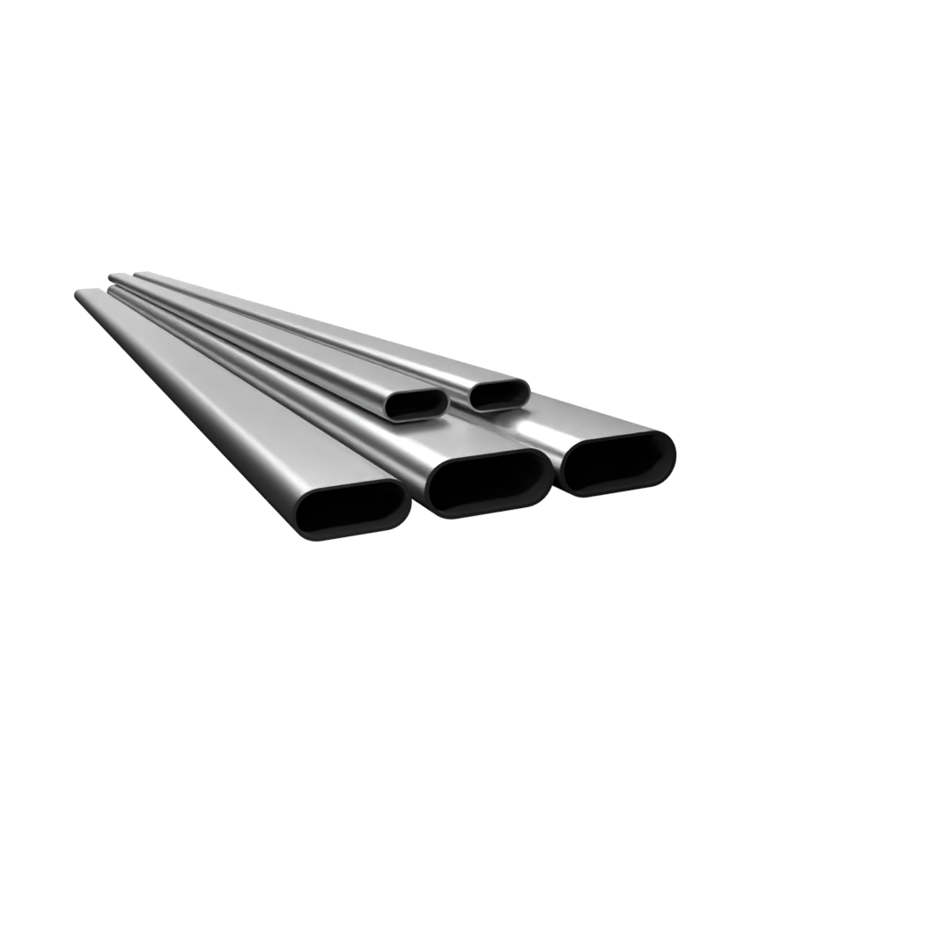
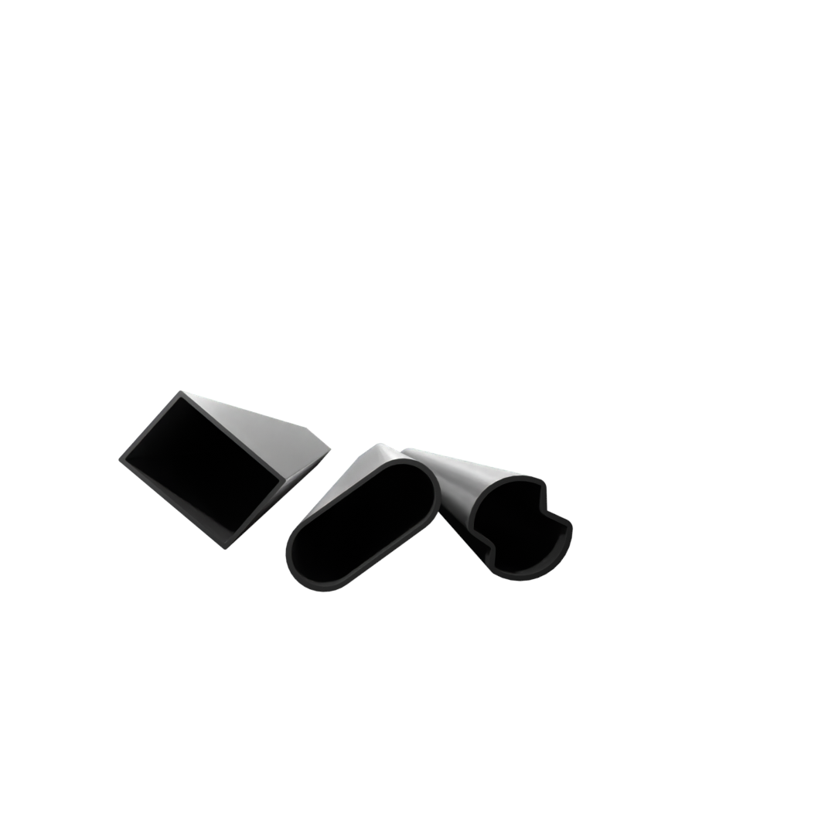
Sample
Various size section
Frontal orthographic projection
Rotated Section

Slide 10
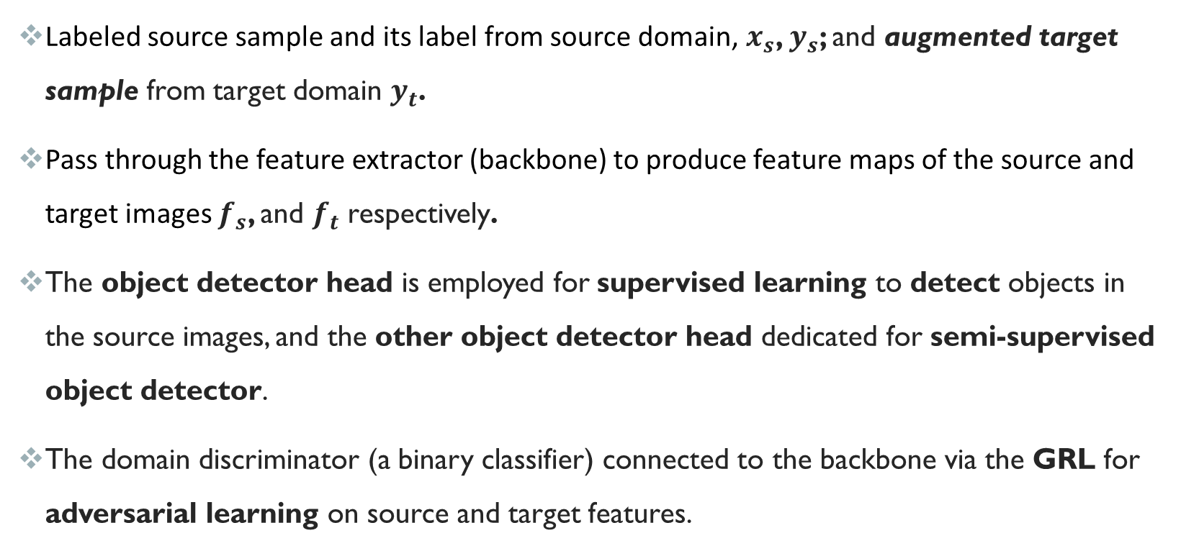
methodology
Labeled source sample and its label from source domain, $x_{s}$, $y_{s}$; and augmented target sample from target domain $y_{t}$.
Pass through the feature extractor (backbone) to produce feature maps of the source and target images $f_{s}$, and $f_{t}$ respectively.
The object detector head is employed for supervised learning to detect objects in the source images, and the other object detector head dedicated for semi-supervised object detector.
The domain discriminator (a binary classifier) connected to the backbone via the GRL for adversarial learning on source and target features.

Slide 11
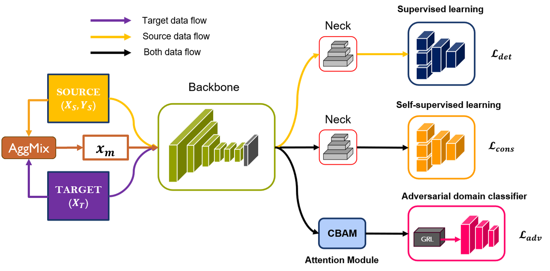
Uda framework

Slide 12
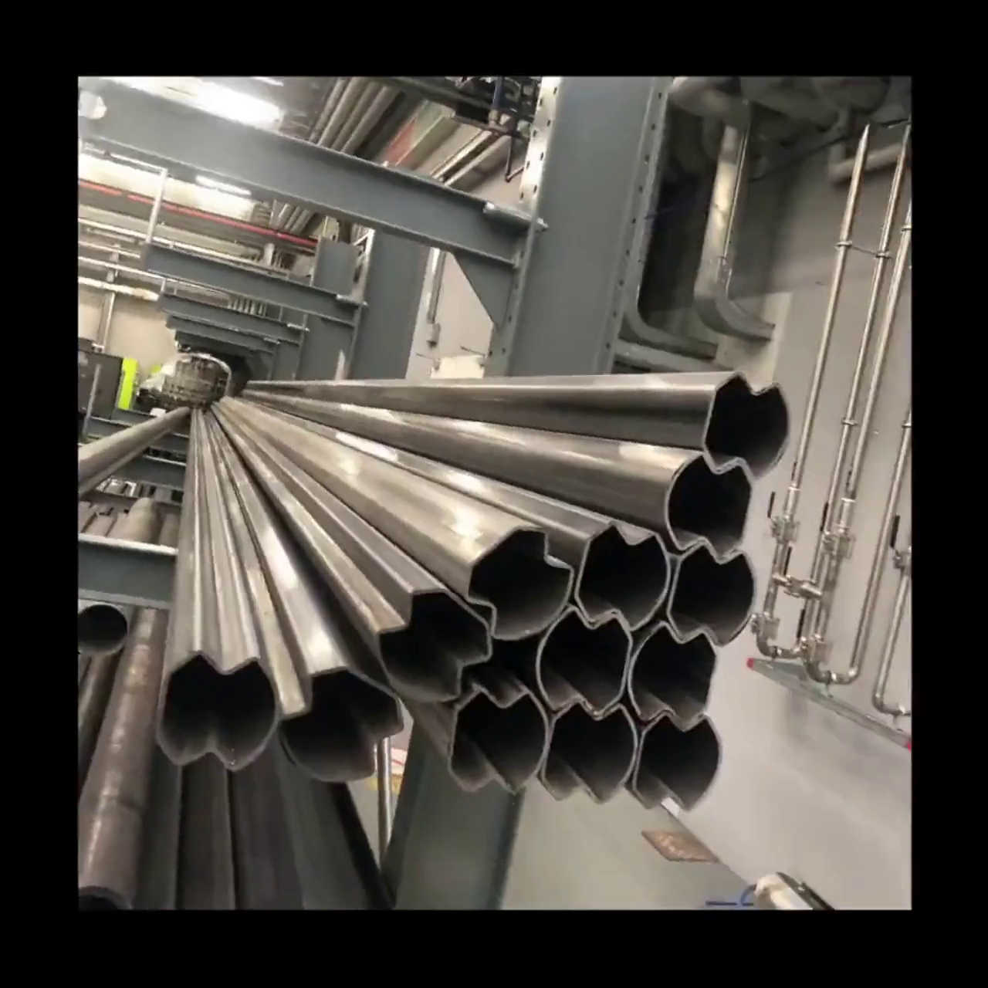
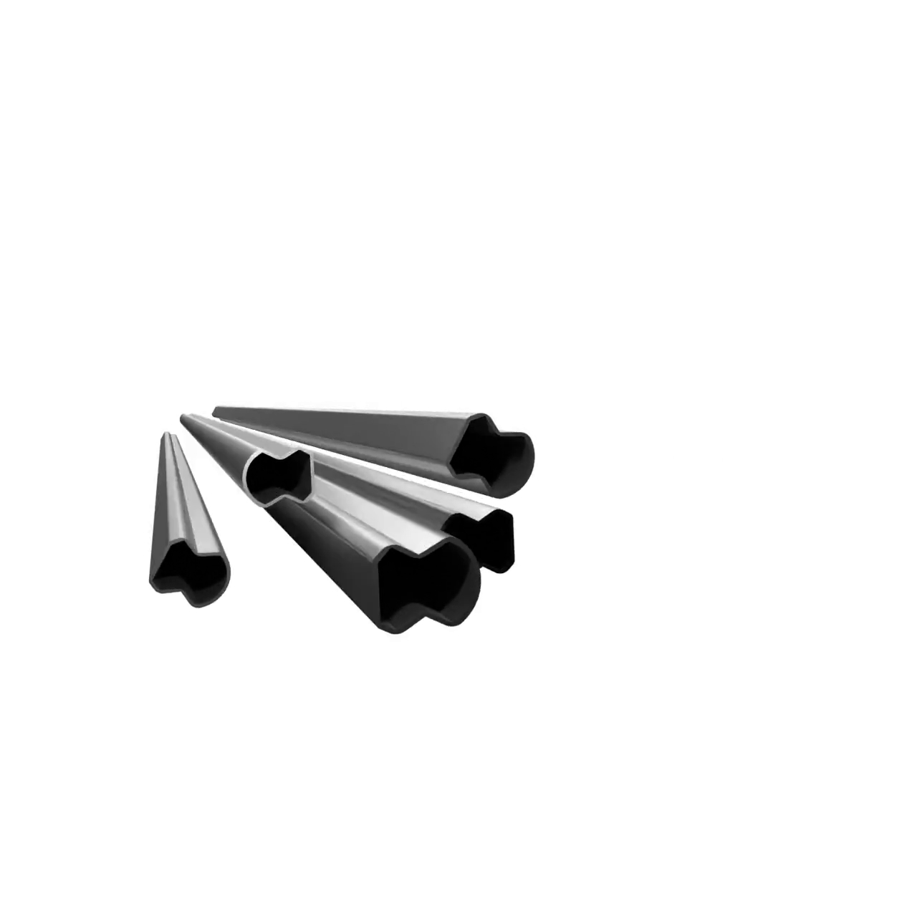
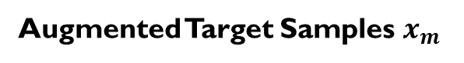
Aggregated mix
AggMix
Augmented Target Samples $x_{m}$

Slide 13
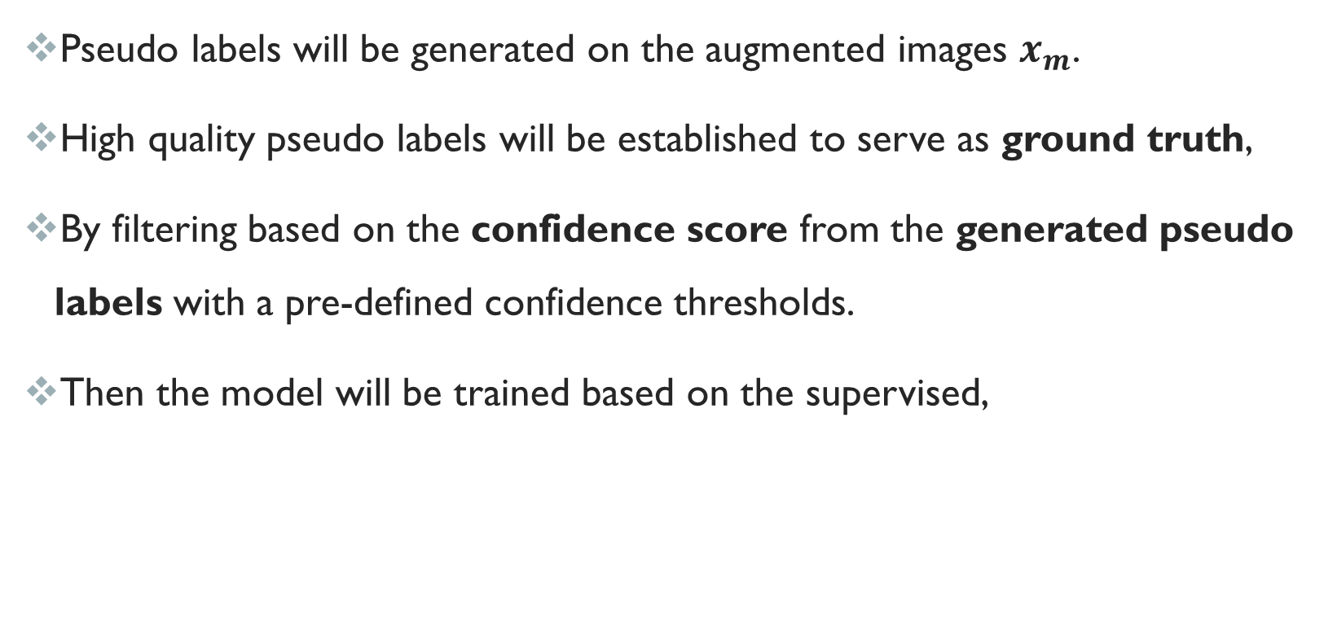
Pseudo labelling
Pseudo labels will be generated on the augmented images $x_{m}$.
High quality pseudo labels will be established to serve as ground truth,
By filtering based on the confidence score from the generated pseudo labels with a pre-defined confidence thresholds.
Then the model will be trained based on the supervised,

Slide 14
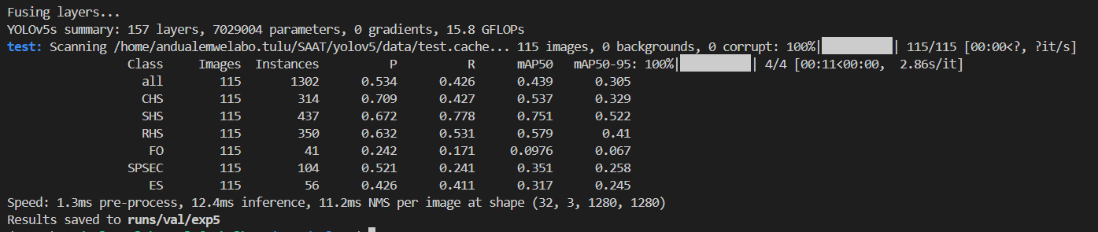
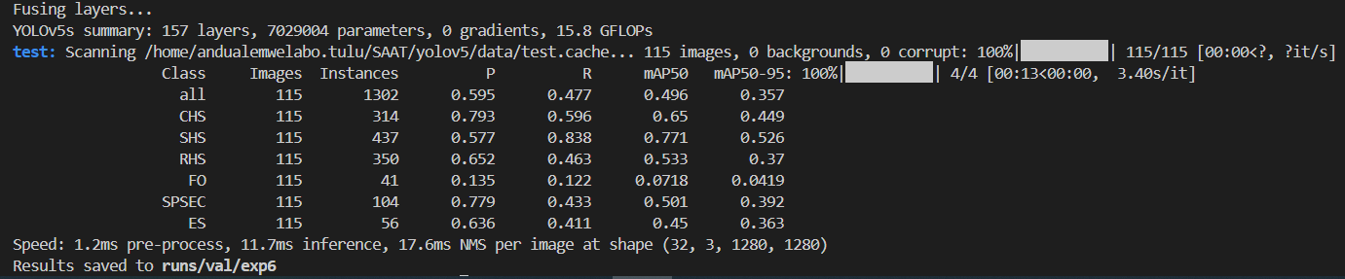
Result and testing
YoloV5 Framework
Our UDA Framework

Slide 15
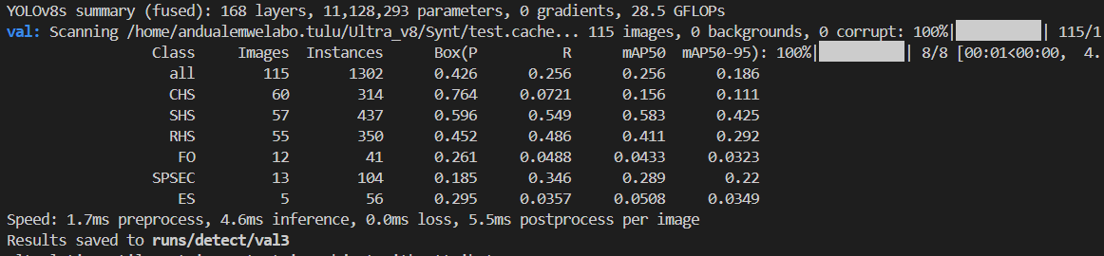
Result and testing
YoloV8 Framework
Our UDA Framework

Slide 16
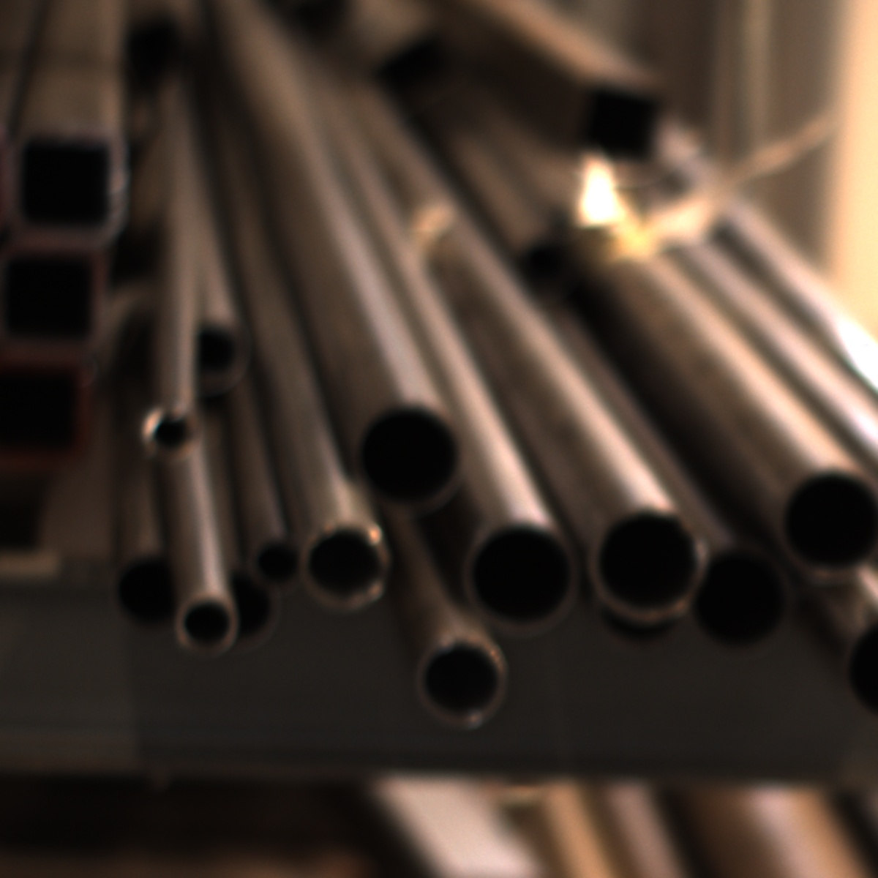
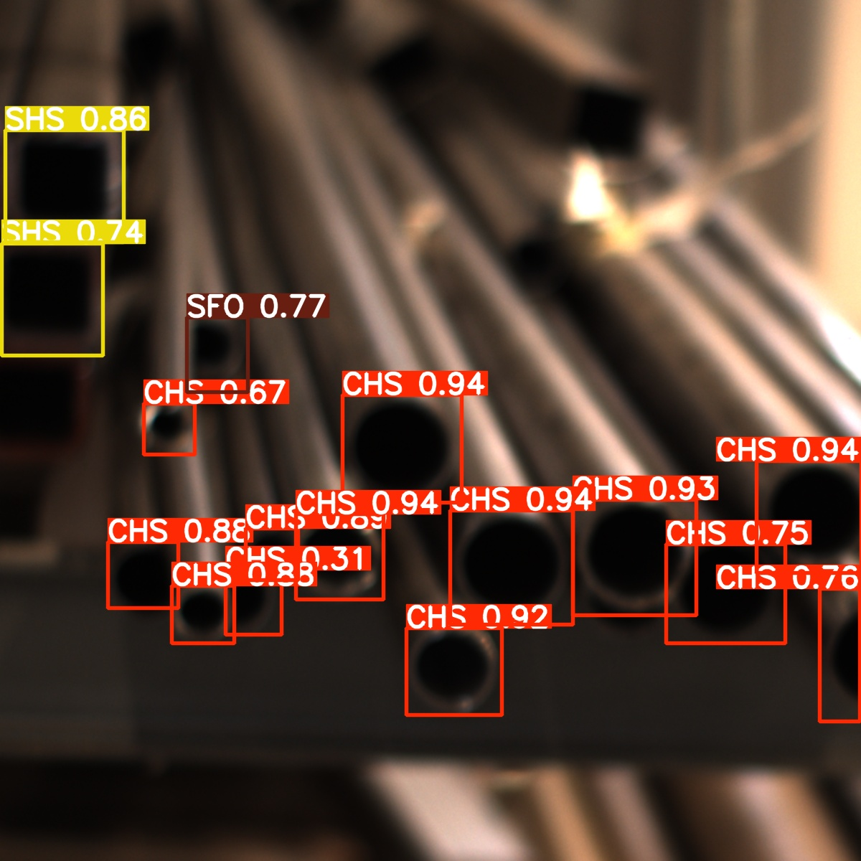
INFERENCE analysis 0

Slide 17
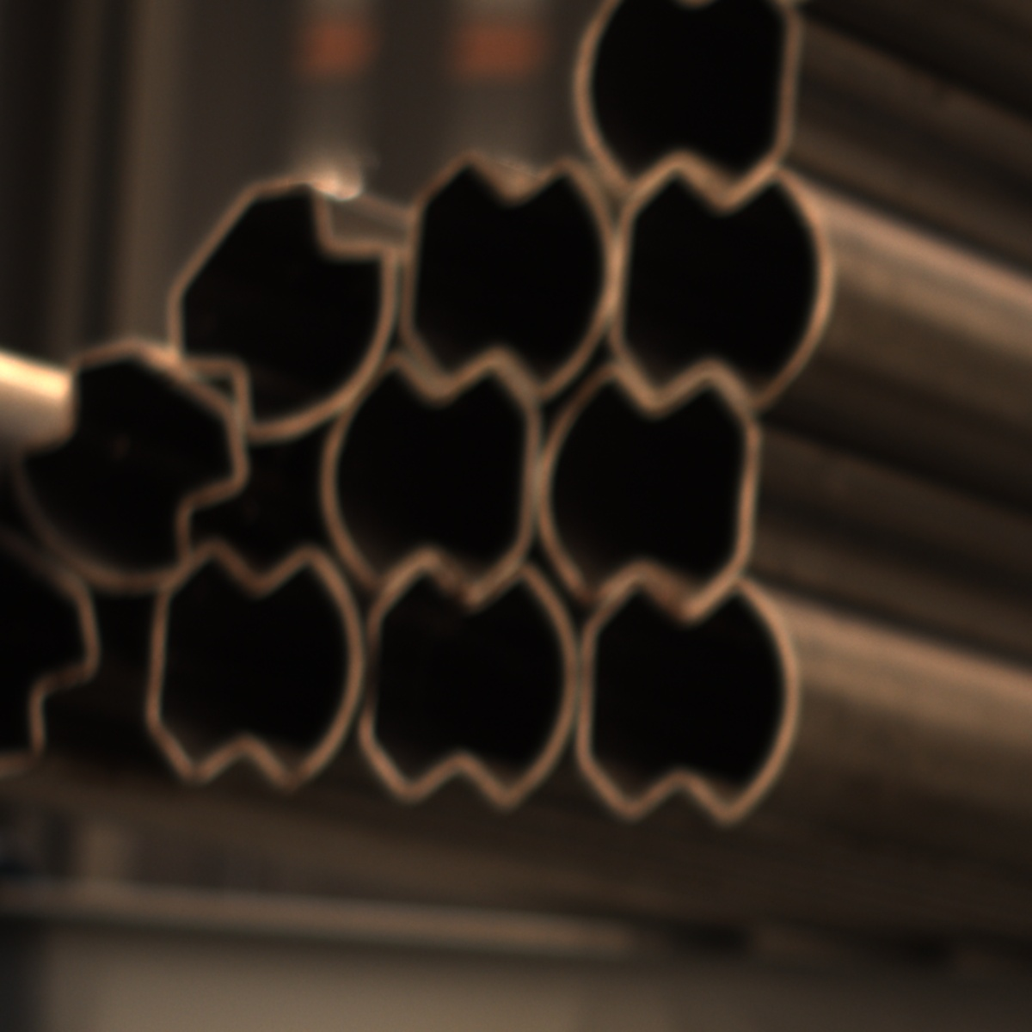
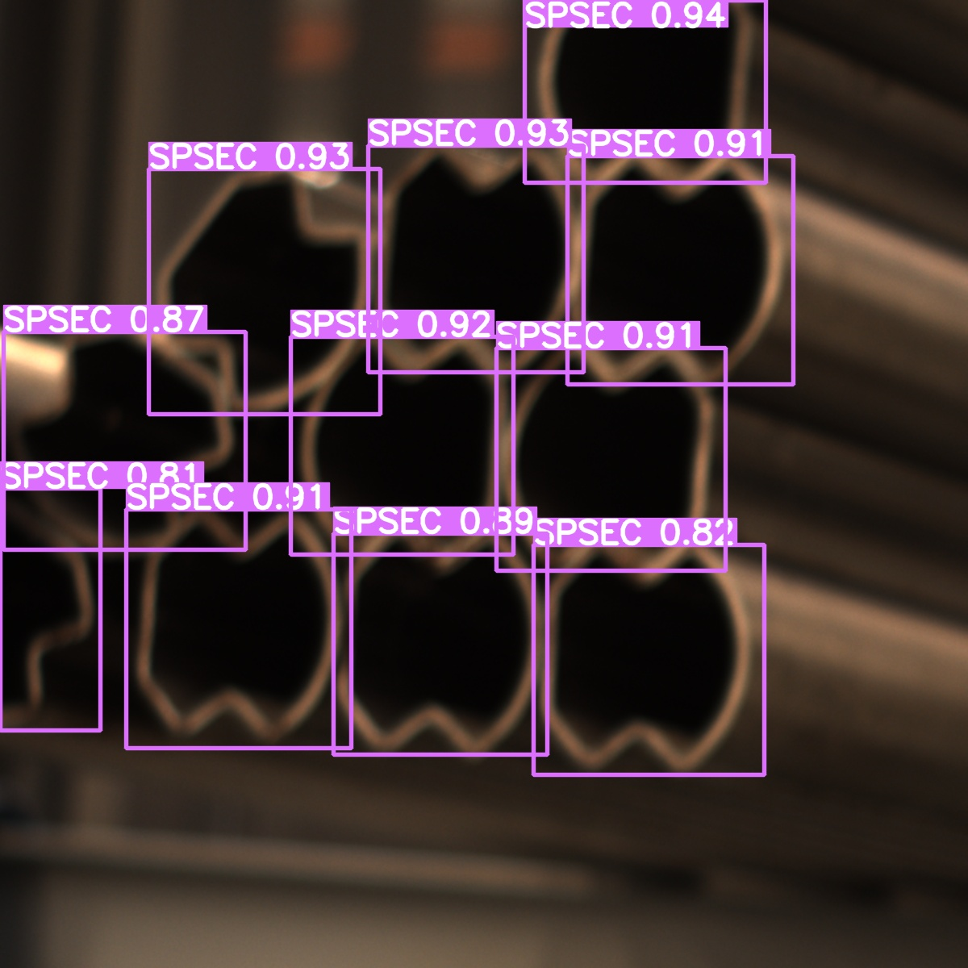
INFERENCE analysis 1

Slide 18
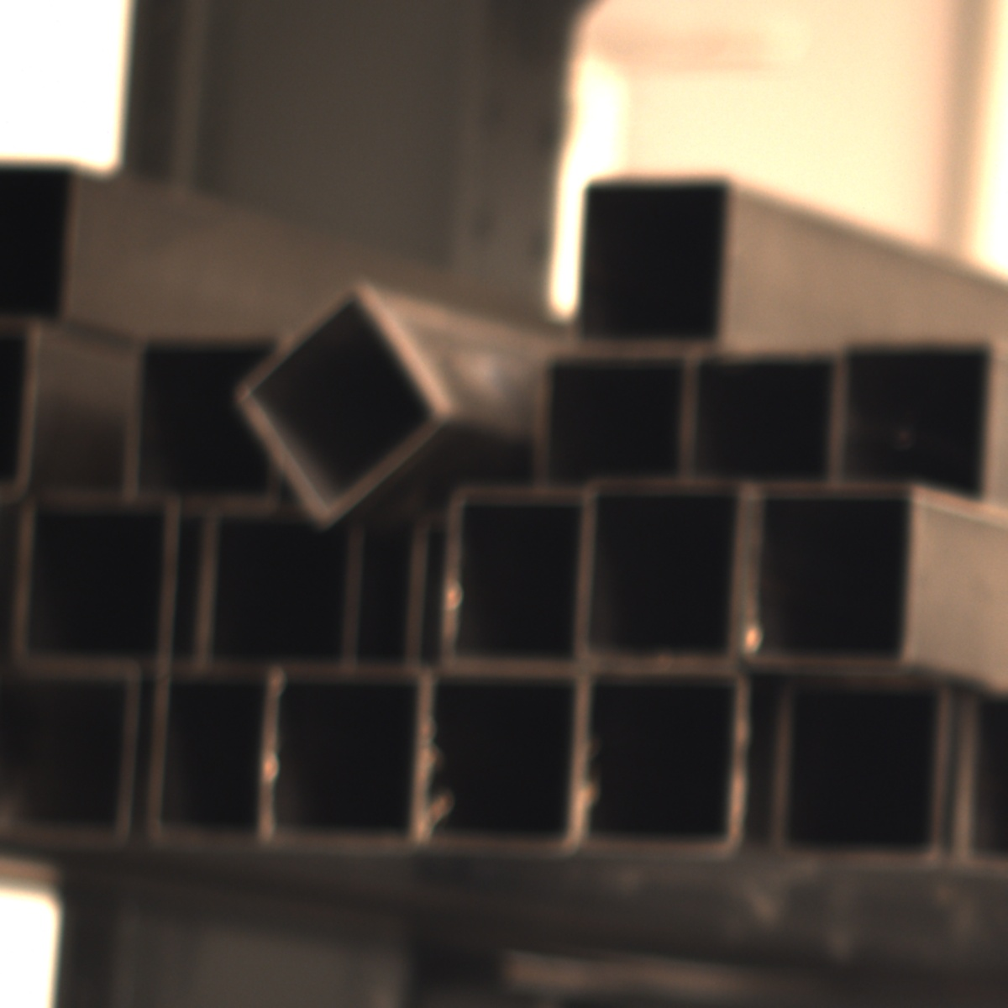
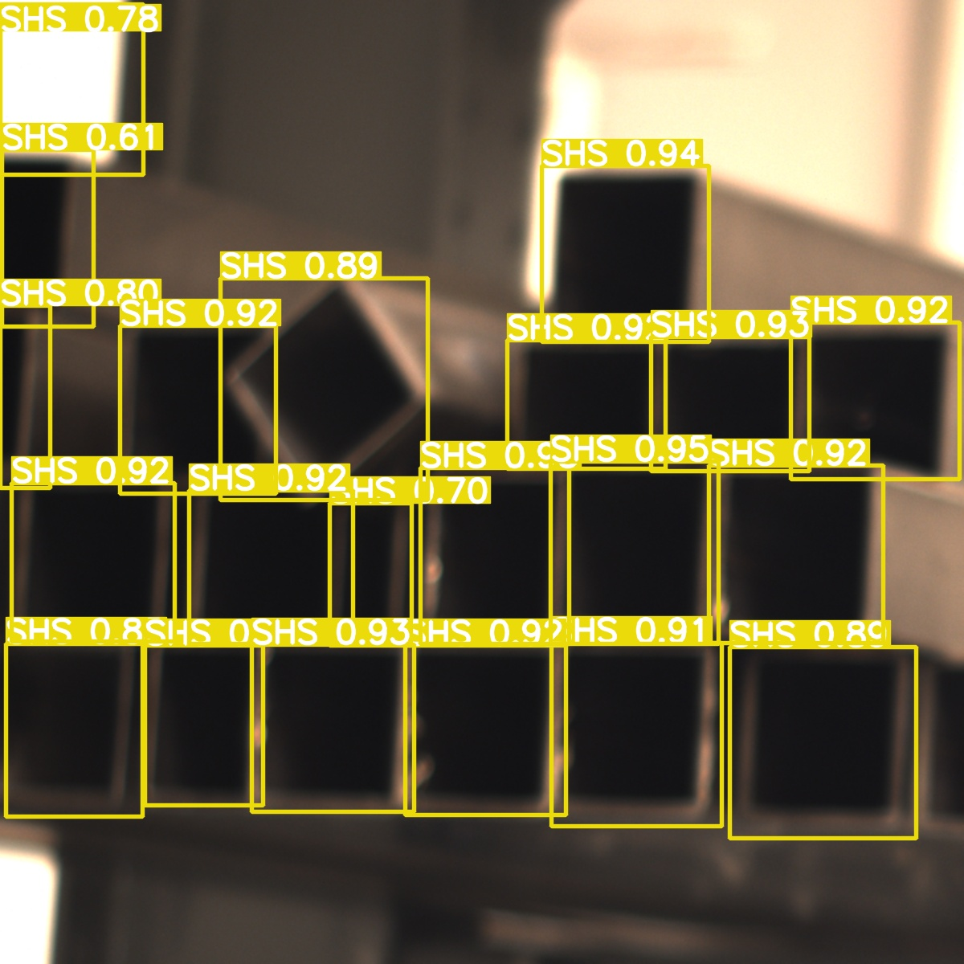
INFERENCE analysis 2

Slide 19
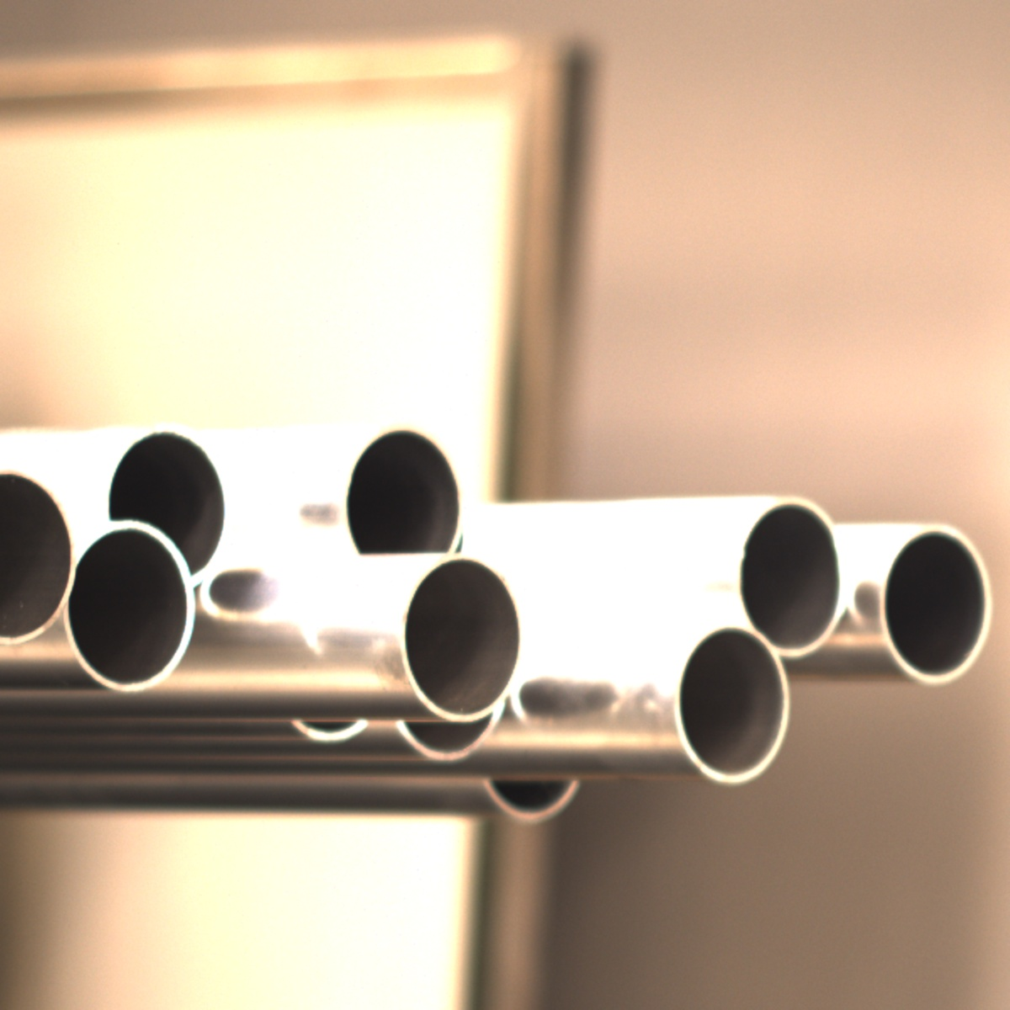
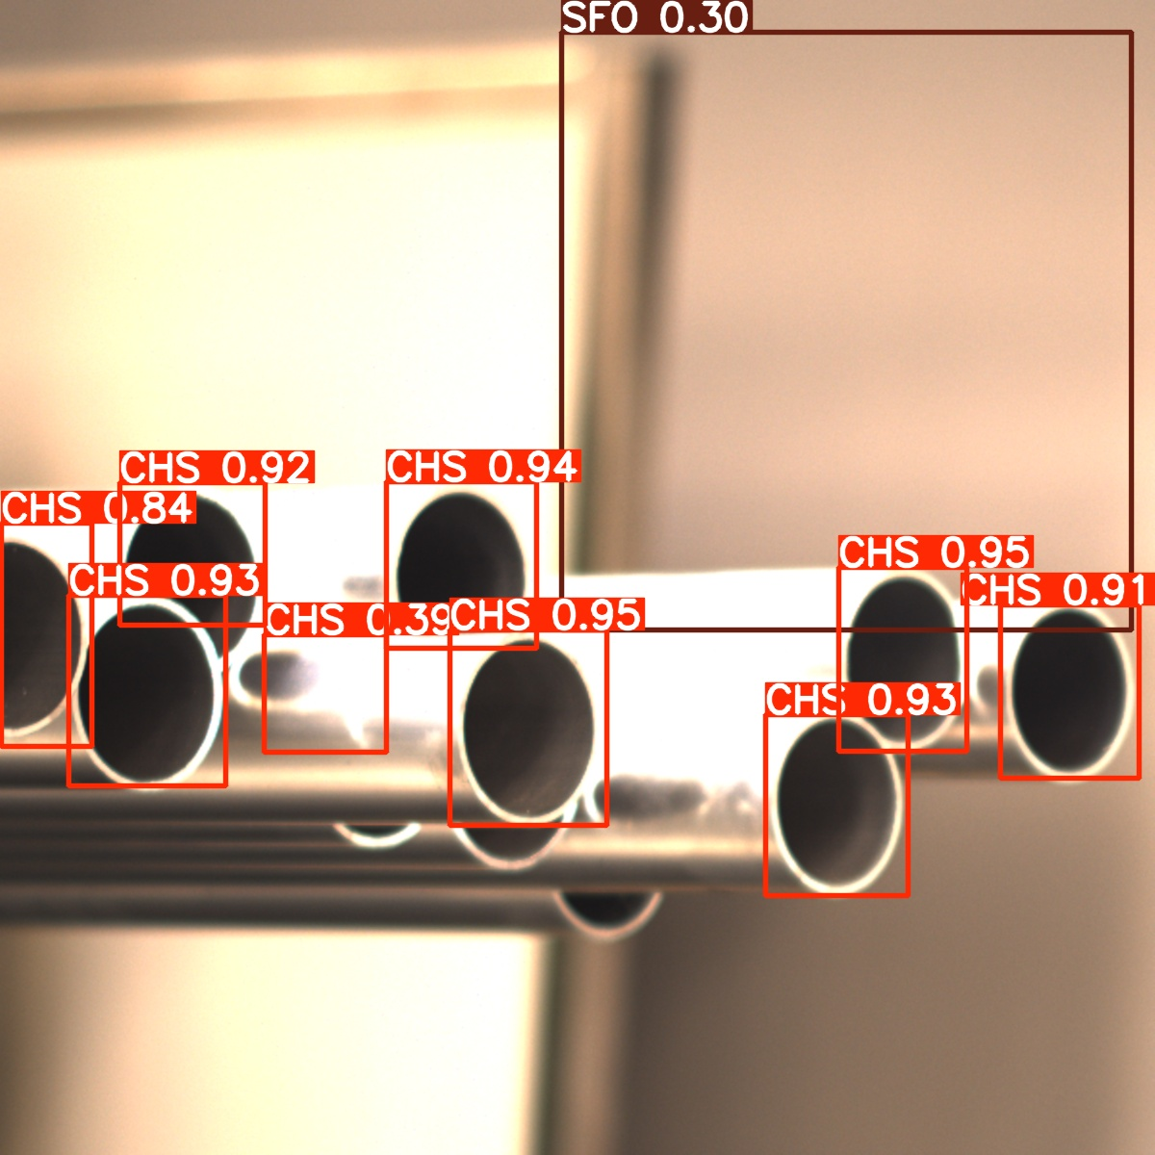
INFERENCE analysis 3

Slide 20
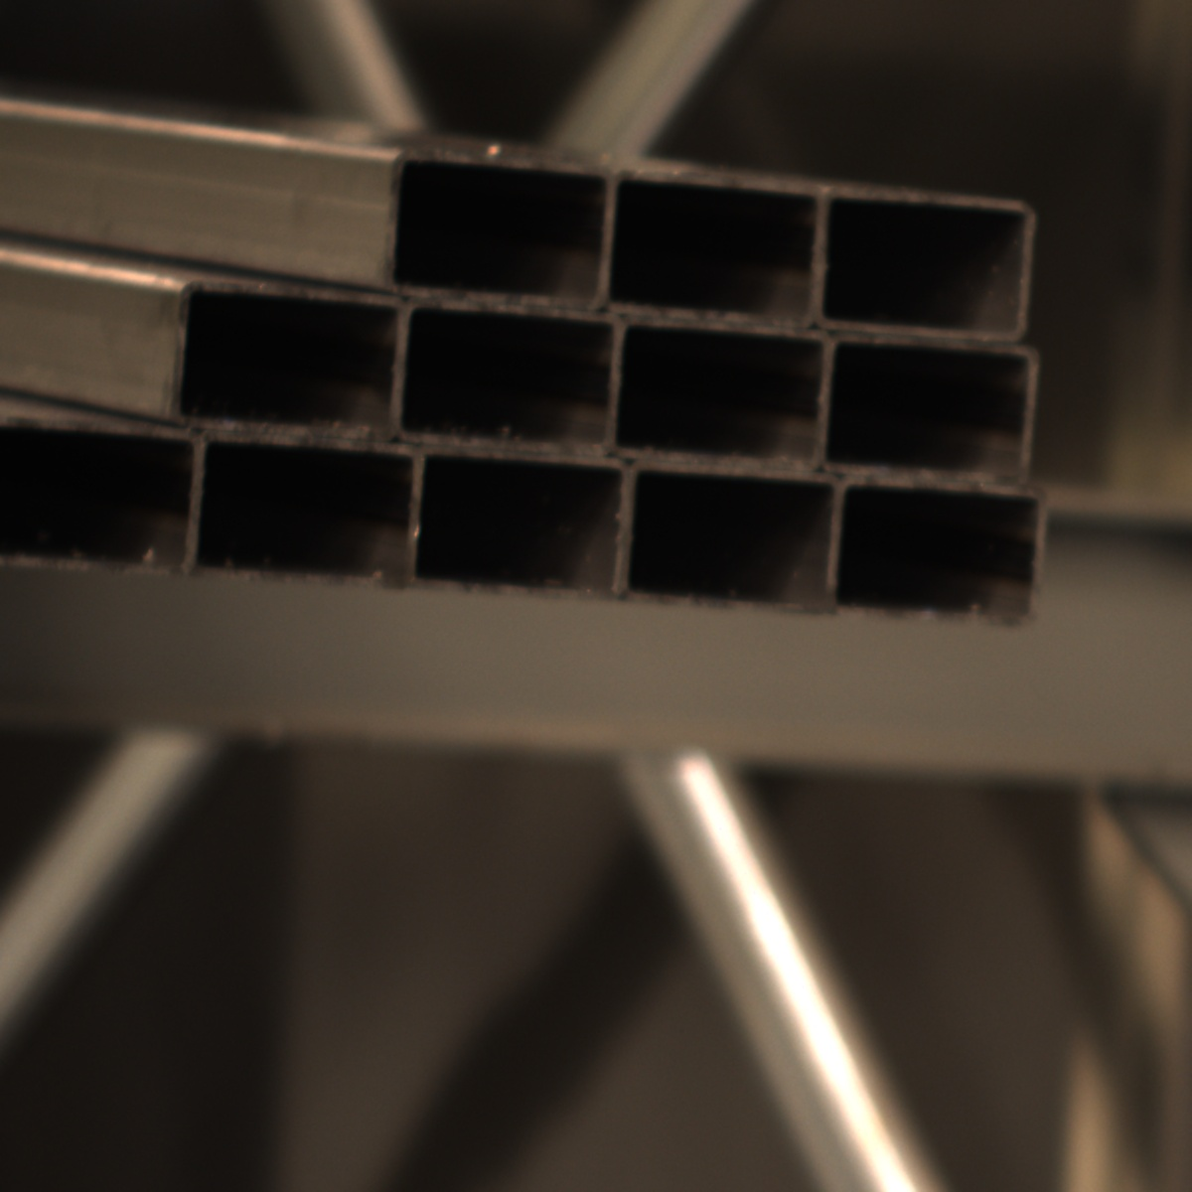
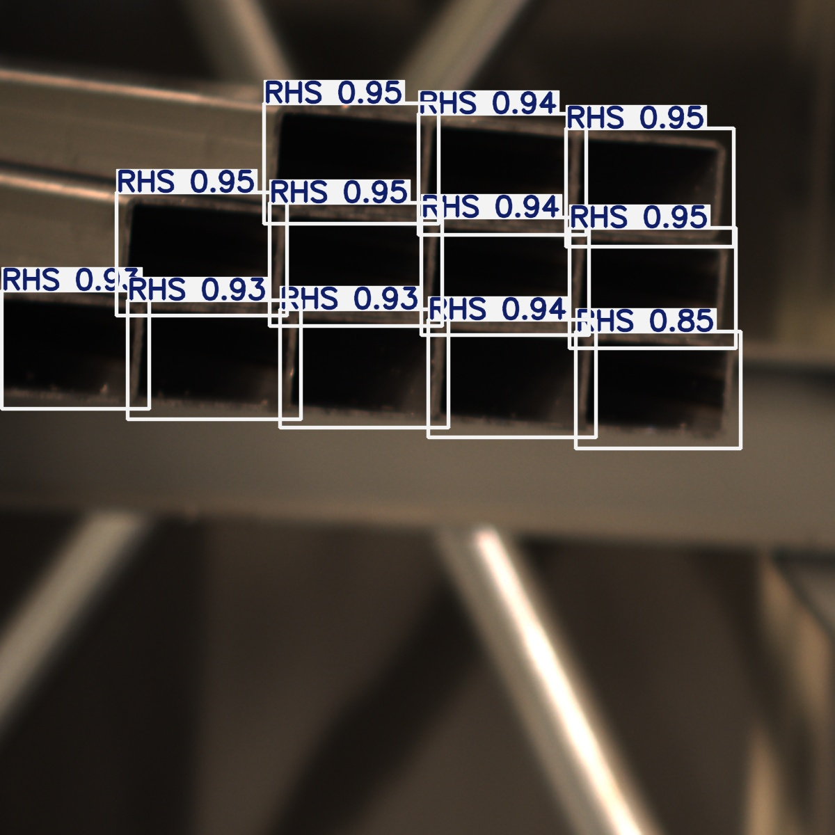
INFERENCE analysis 4

Slide 21
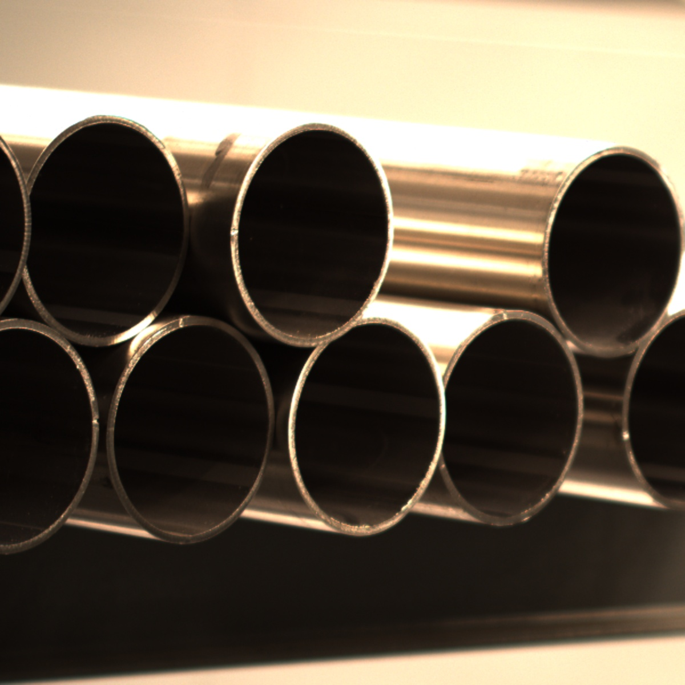
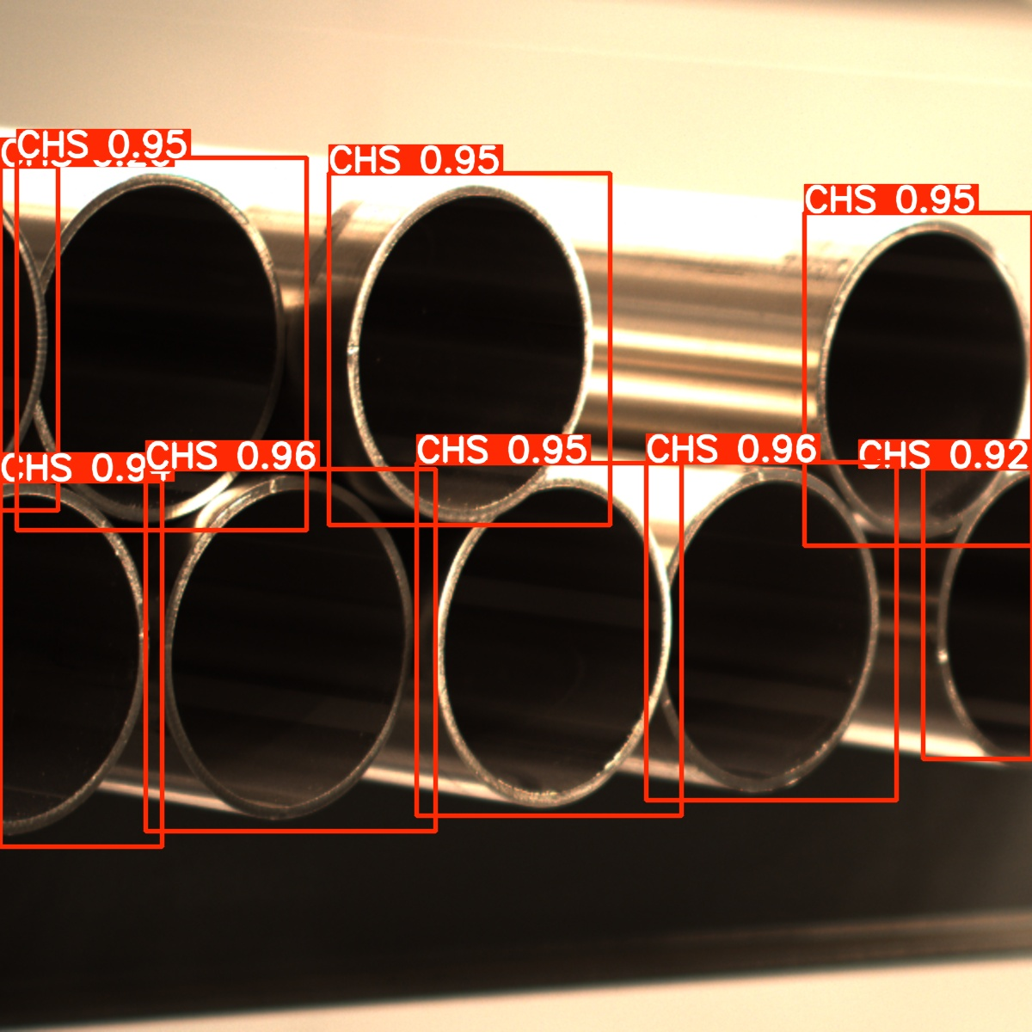
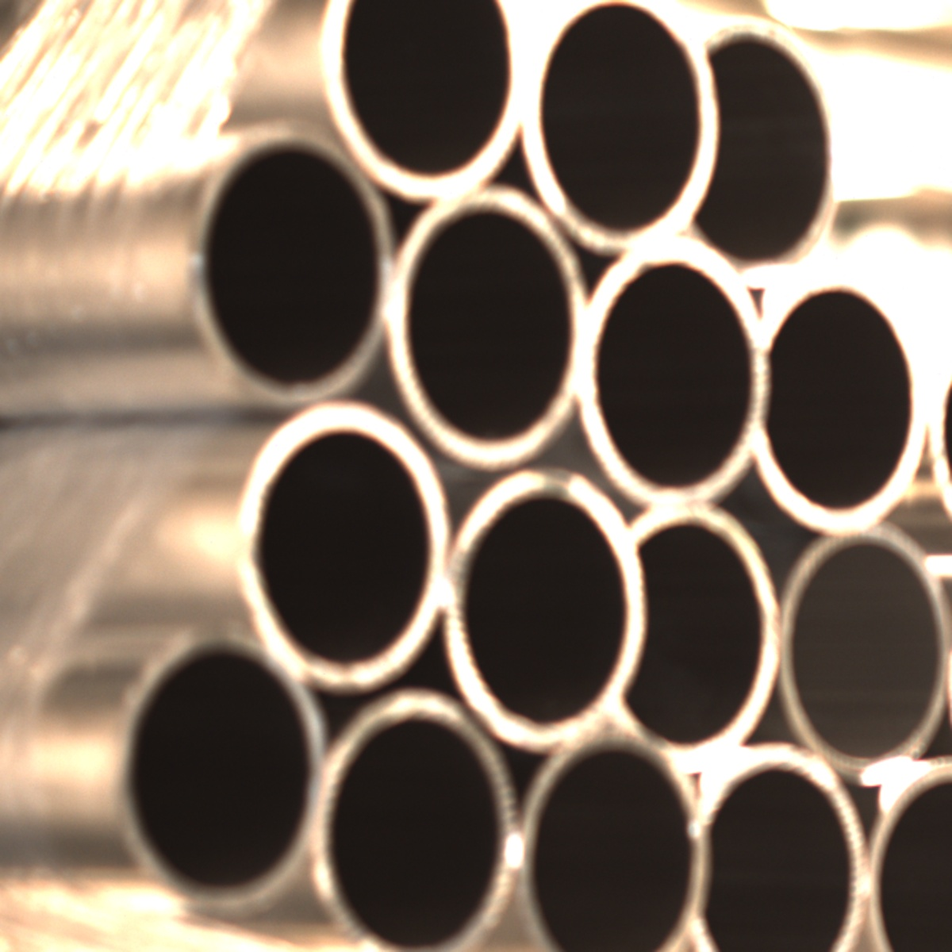
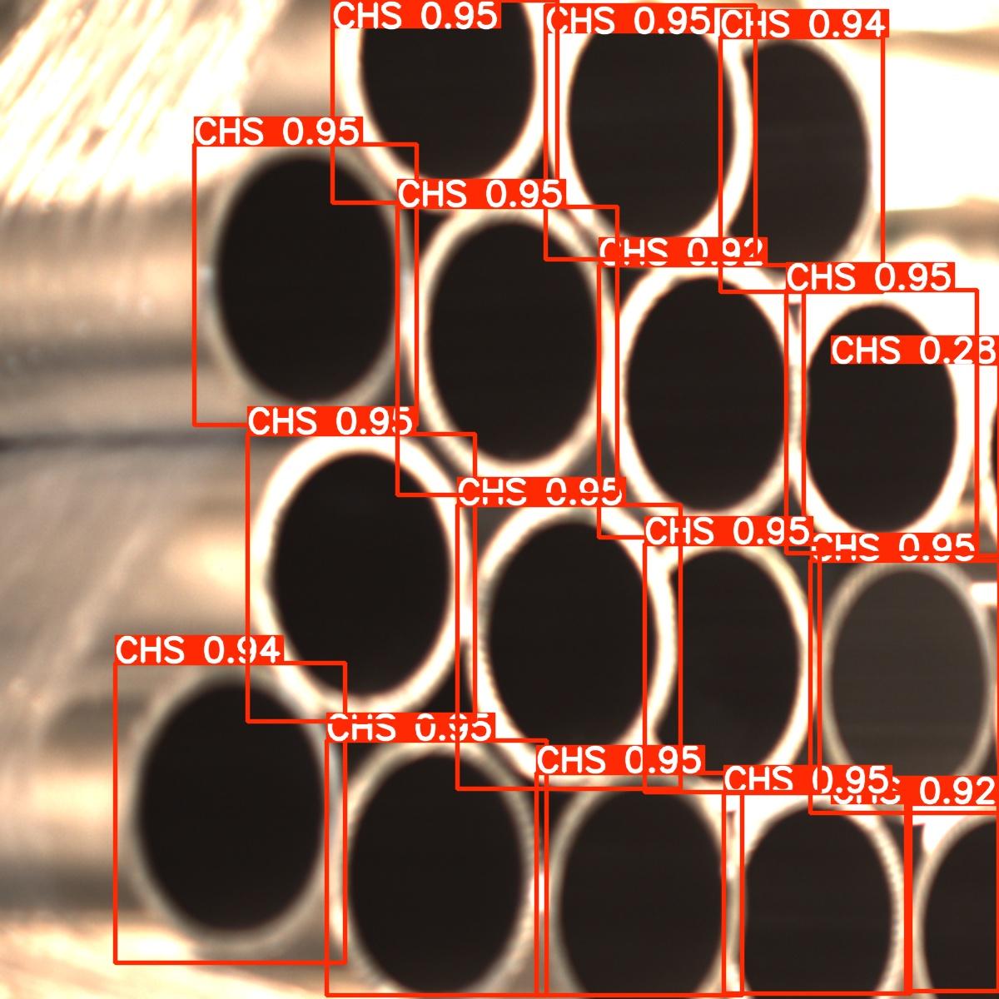

Slide 22
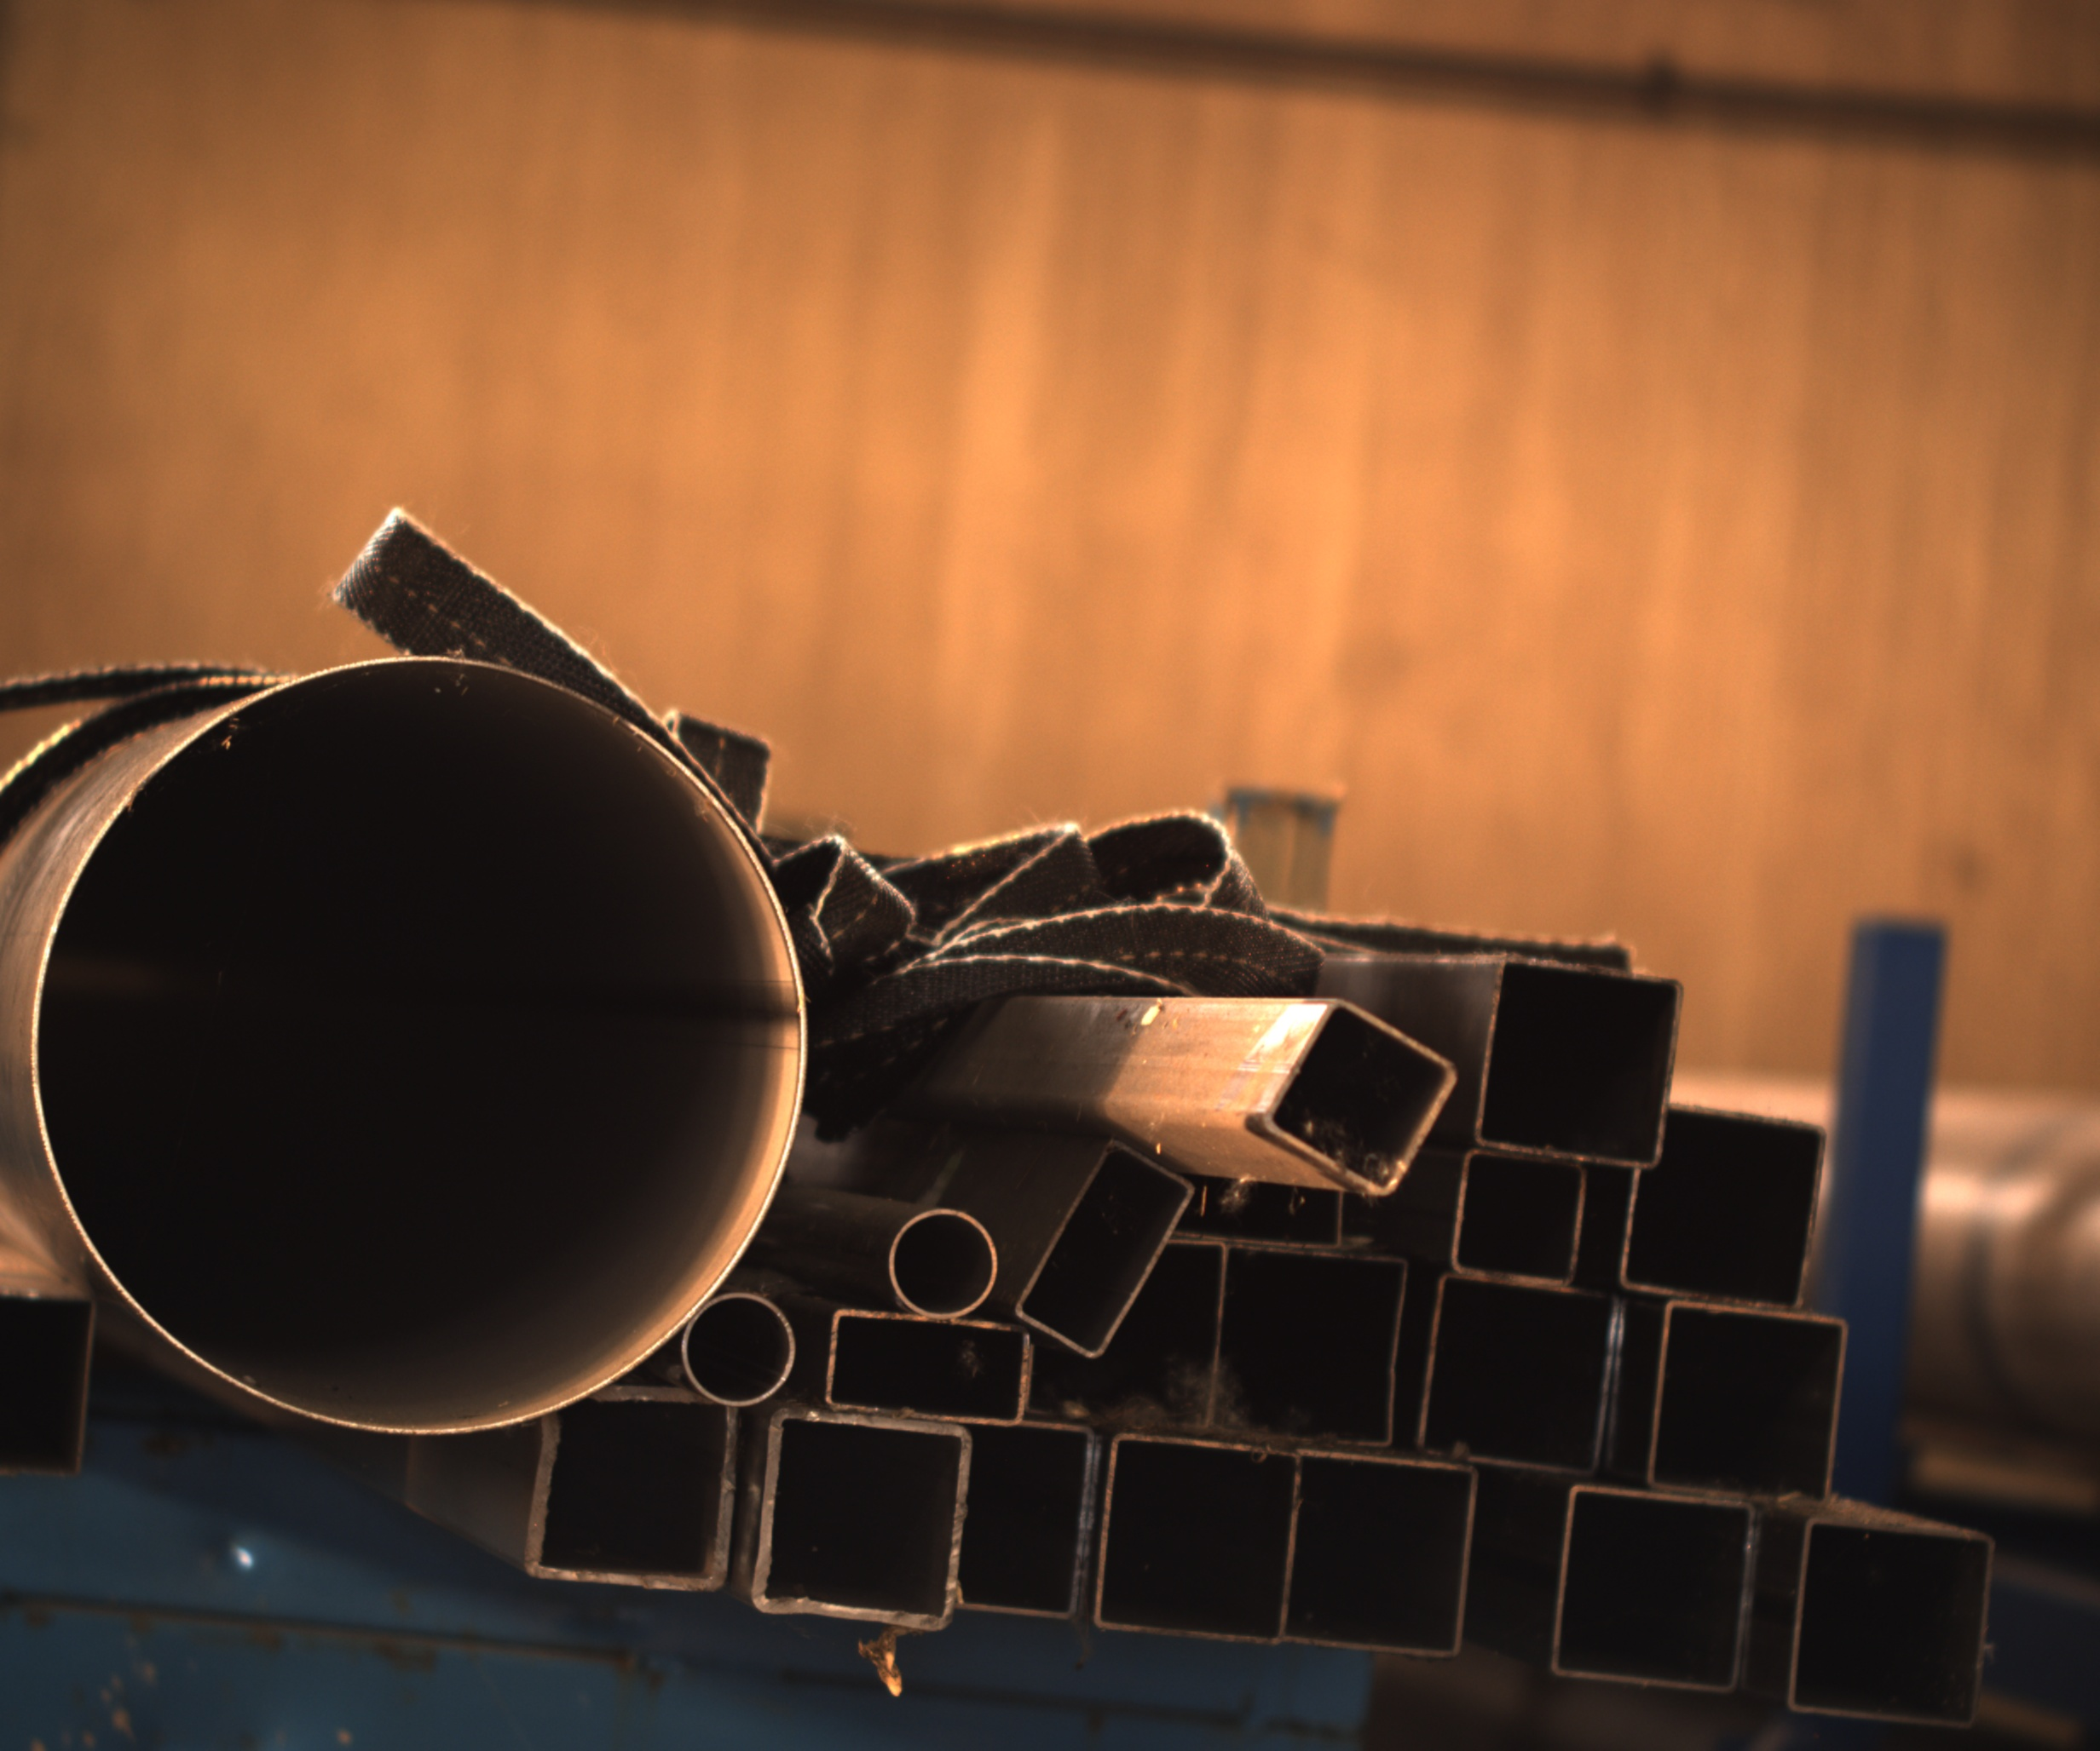
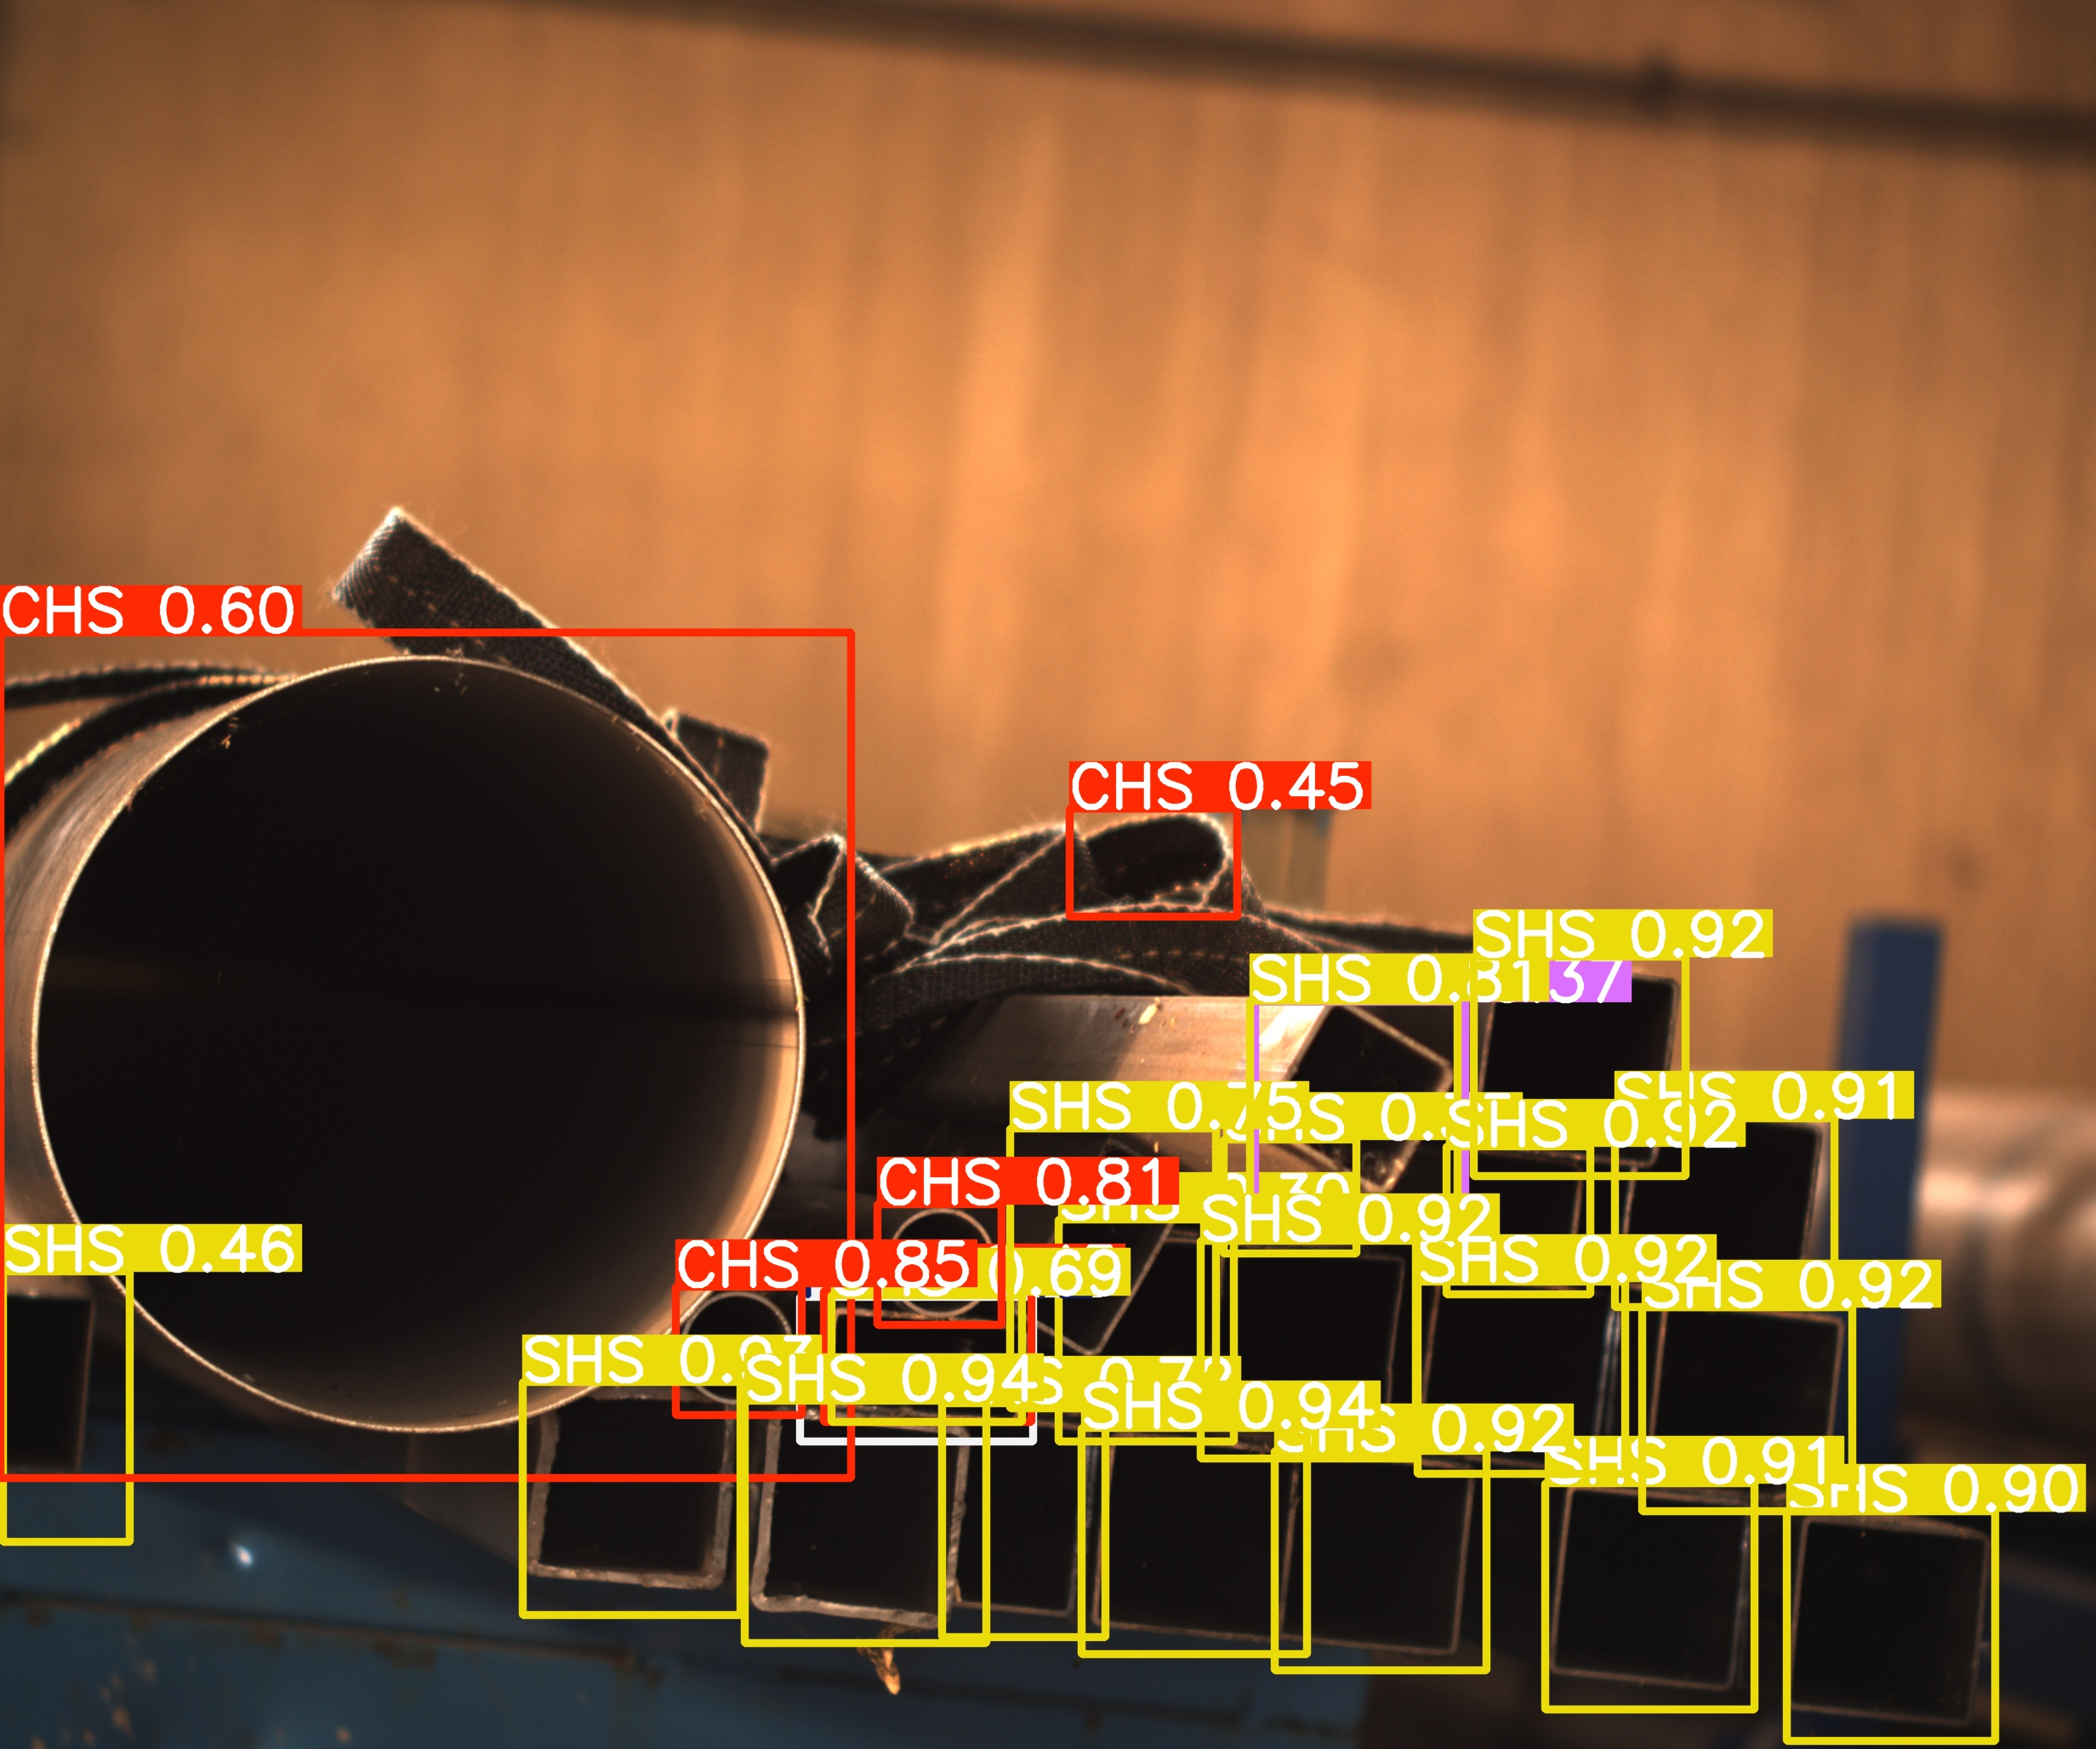
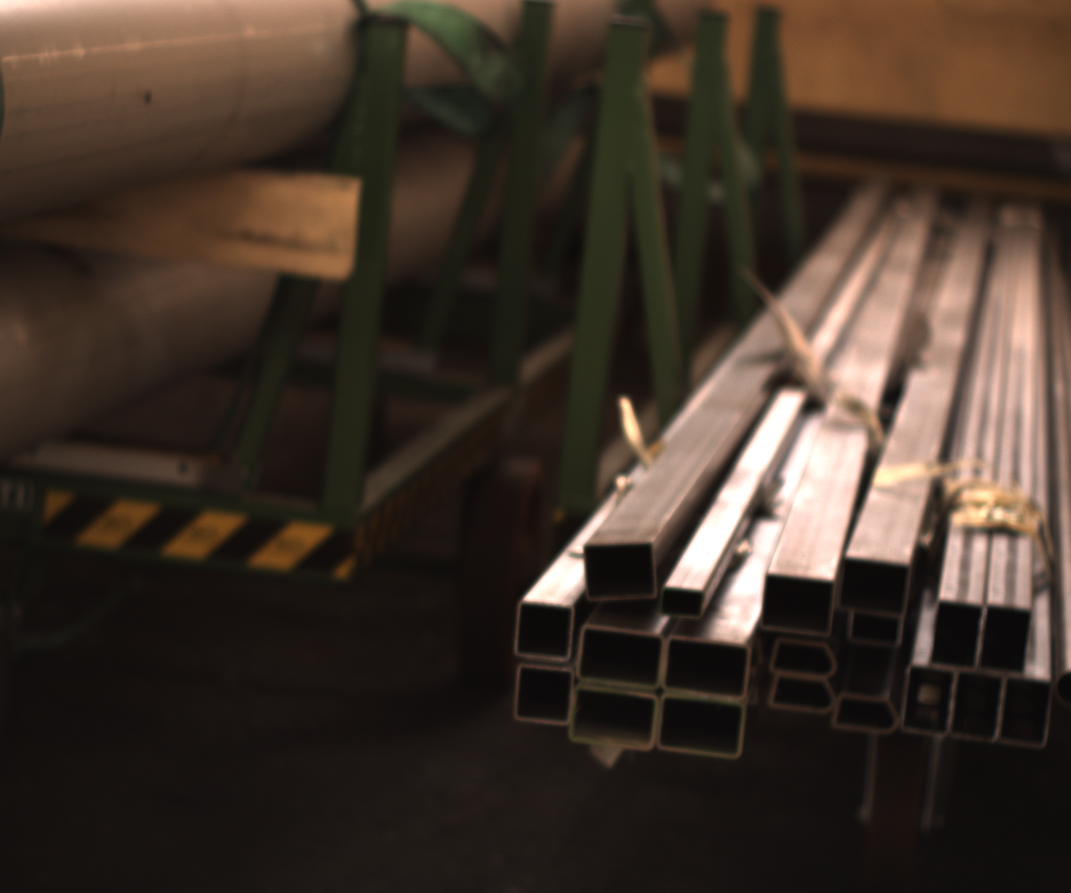
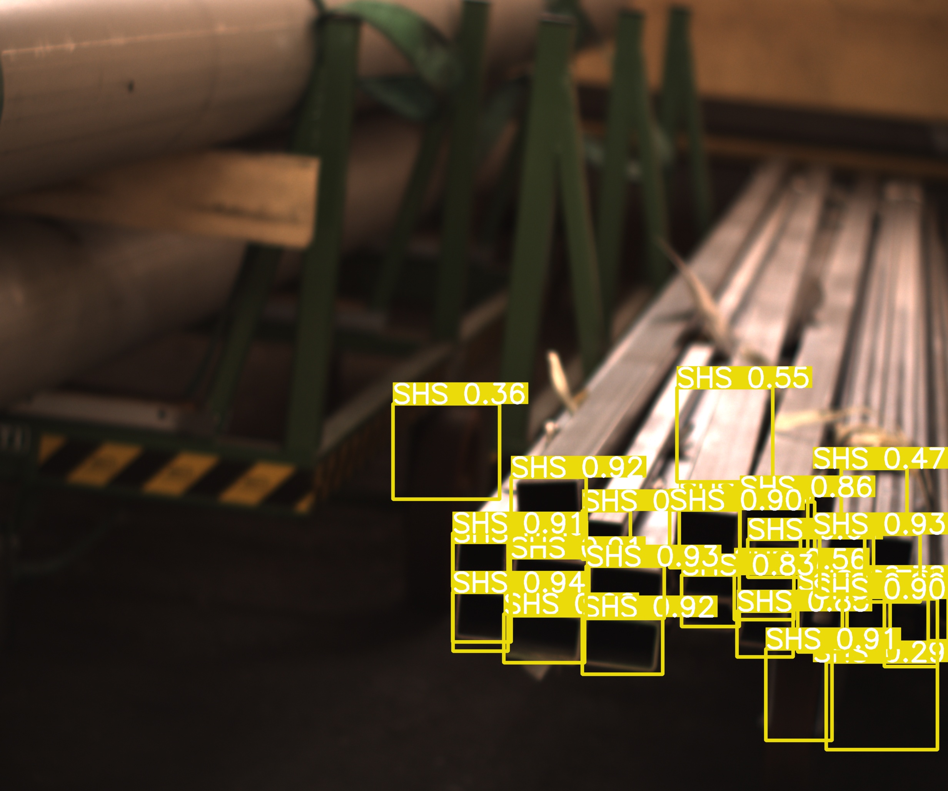

Slide 23
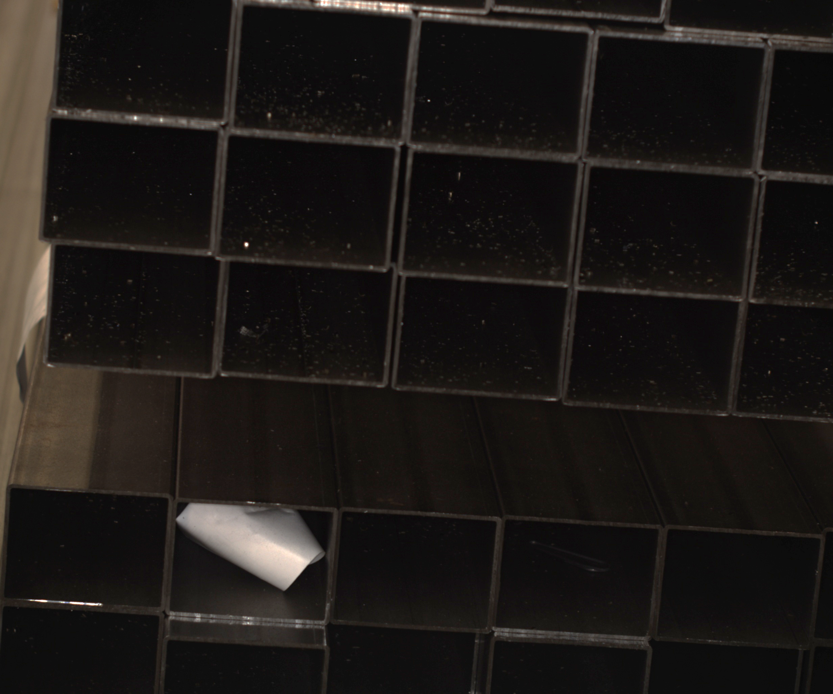
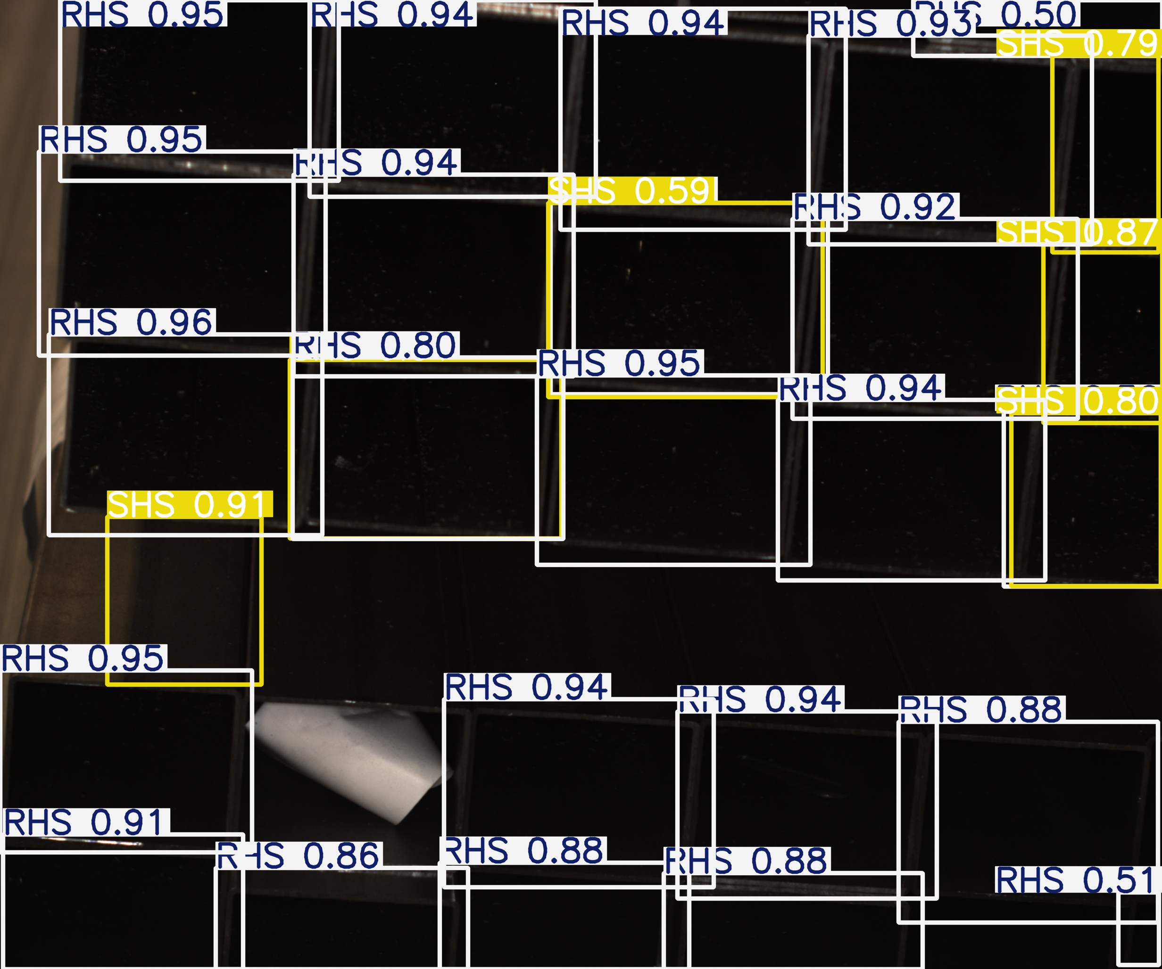
INFERENCE analysis 5

Slide 24
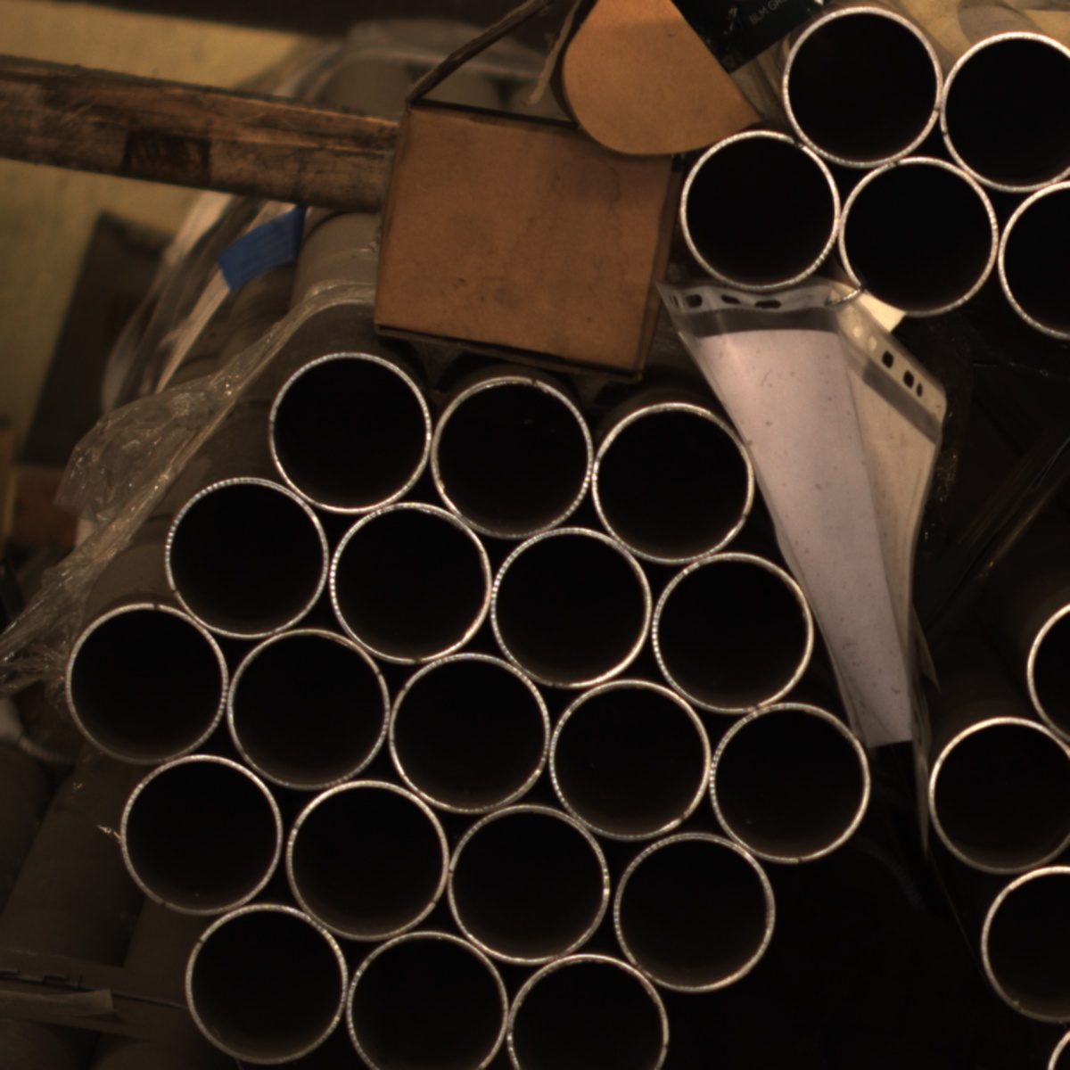
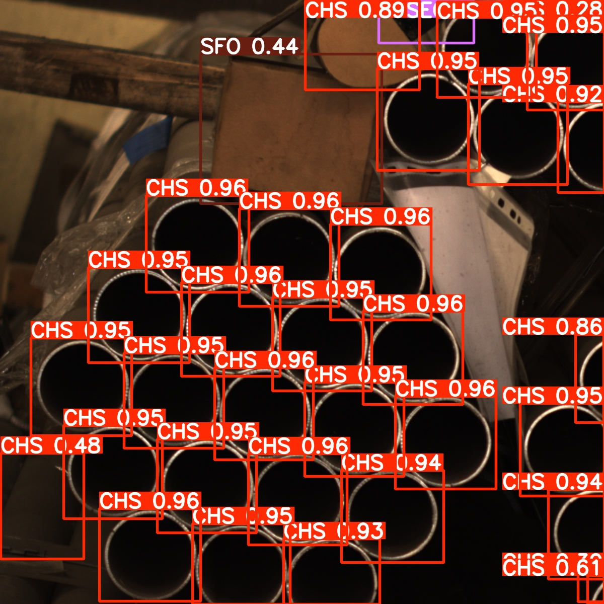
INFERENCE analysis 6

Slide 25
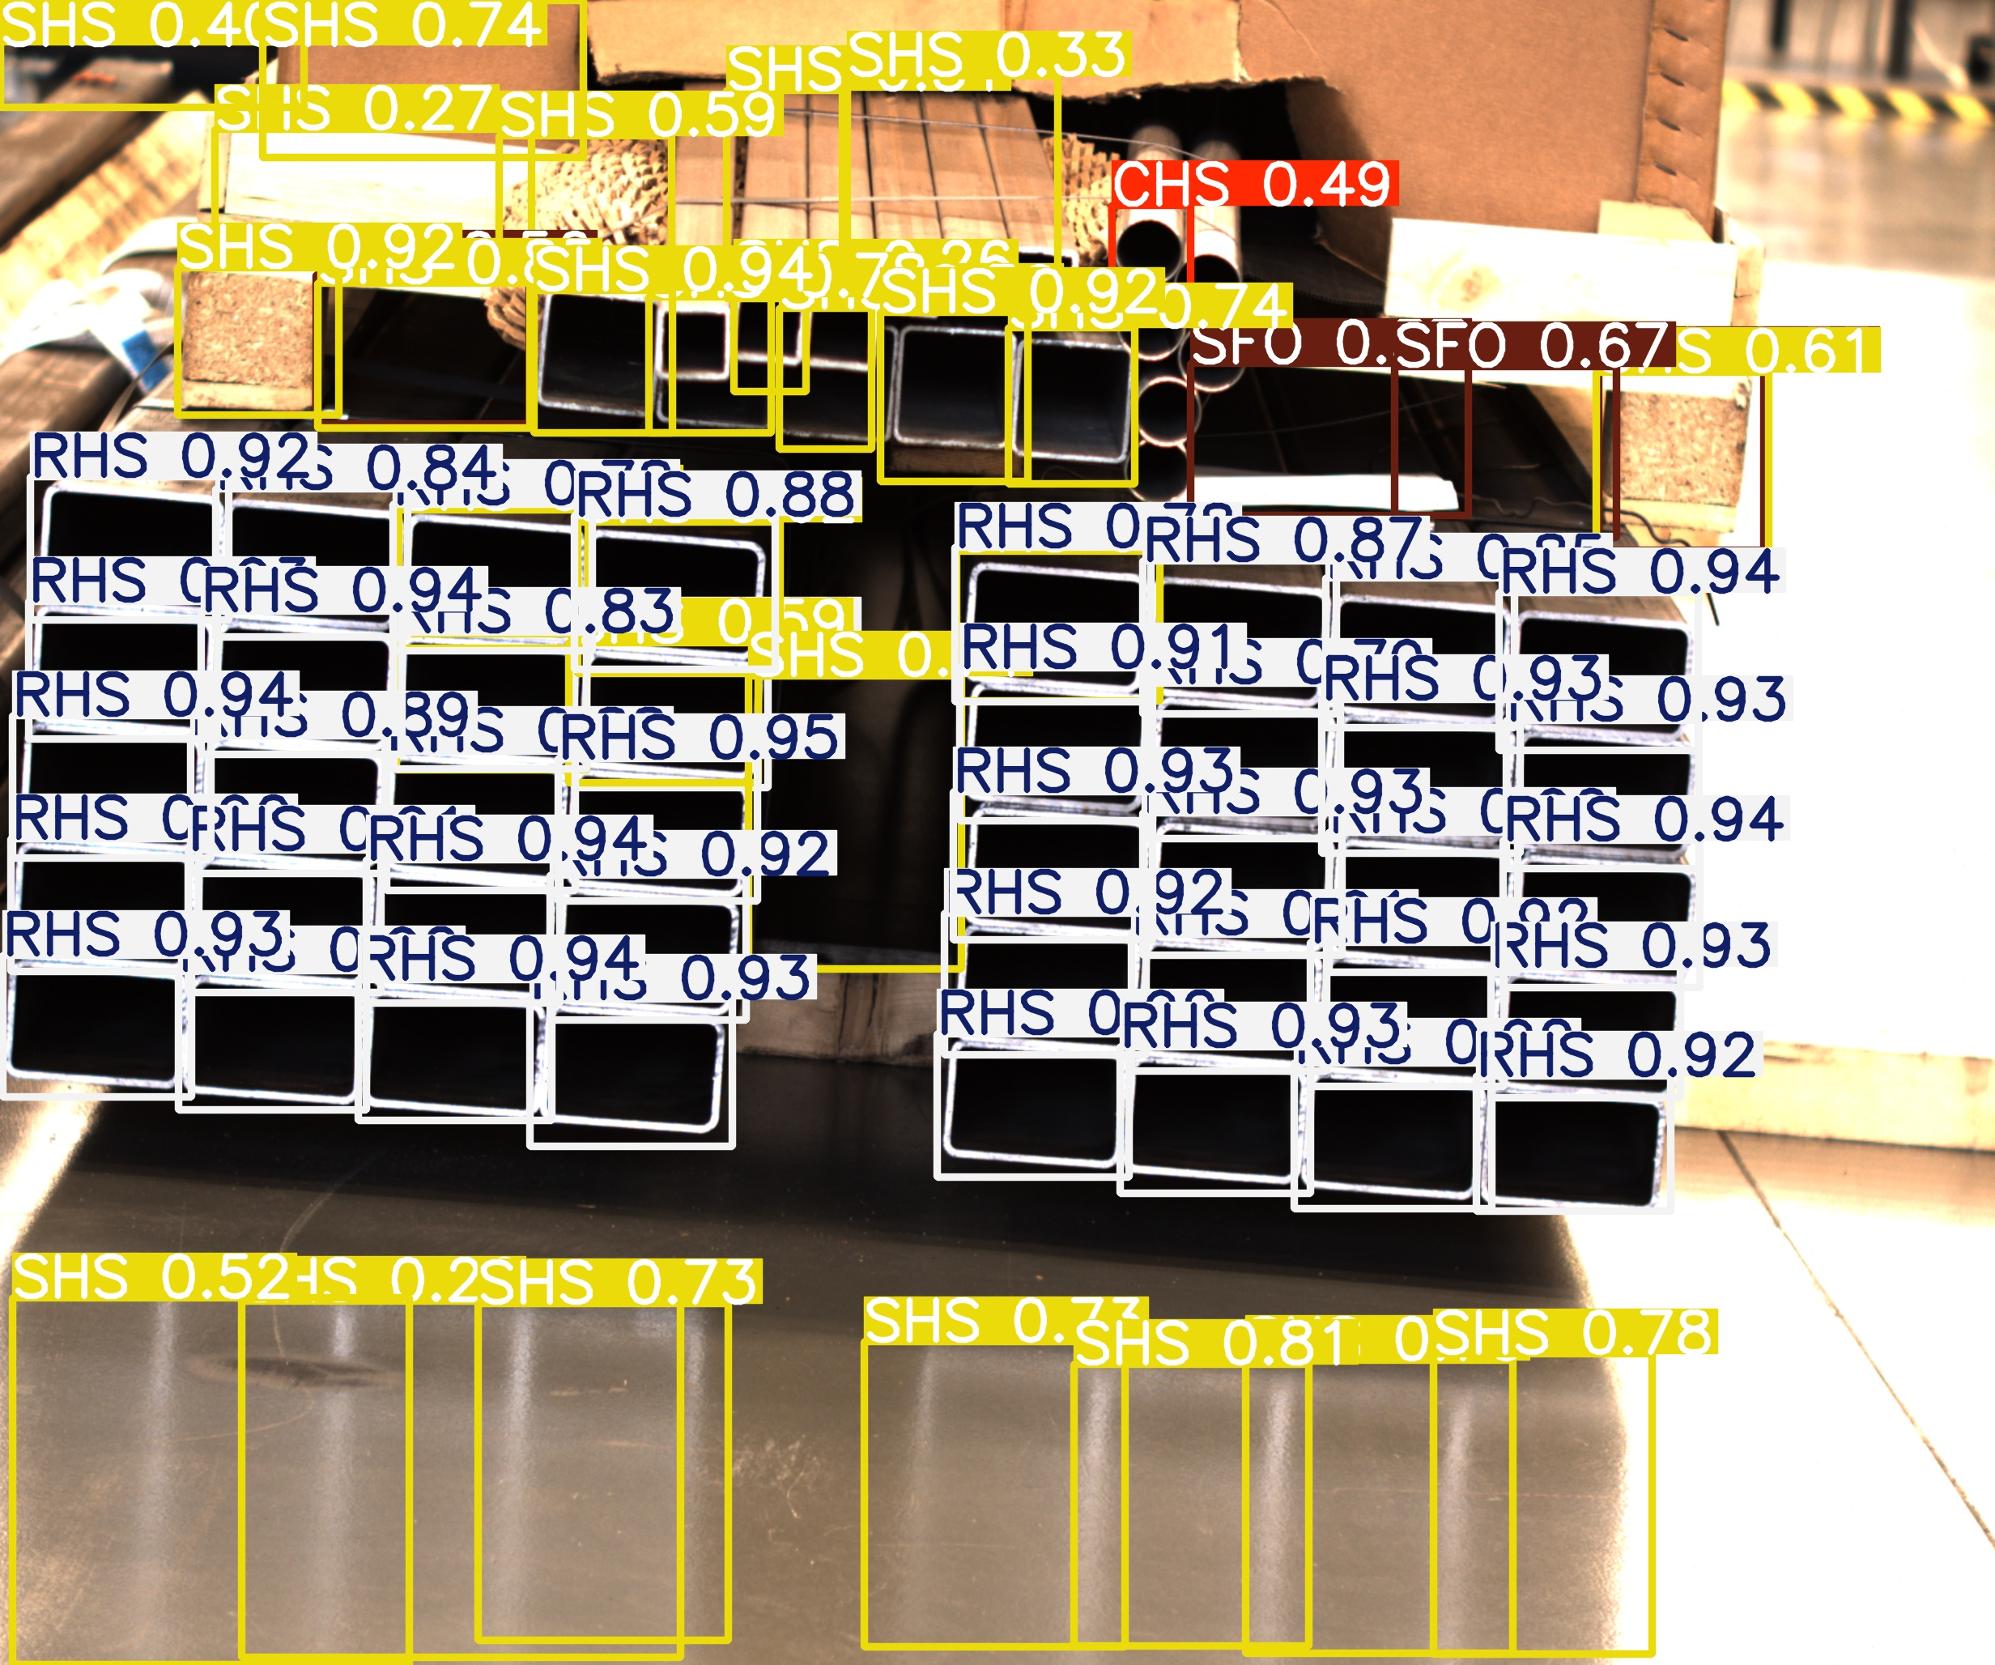
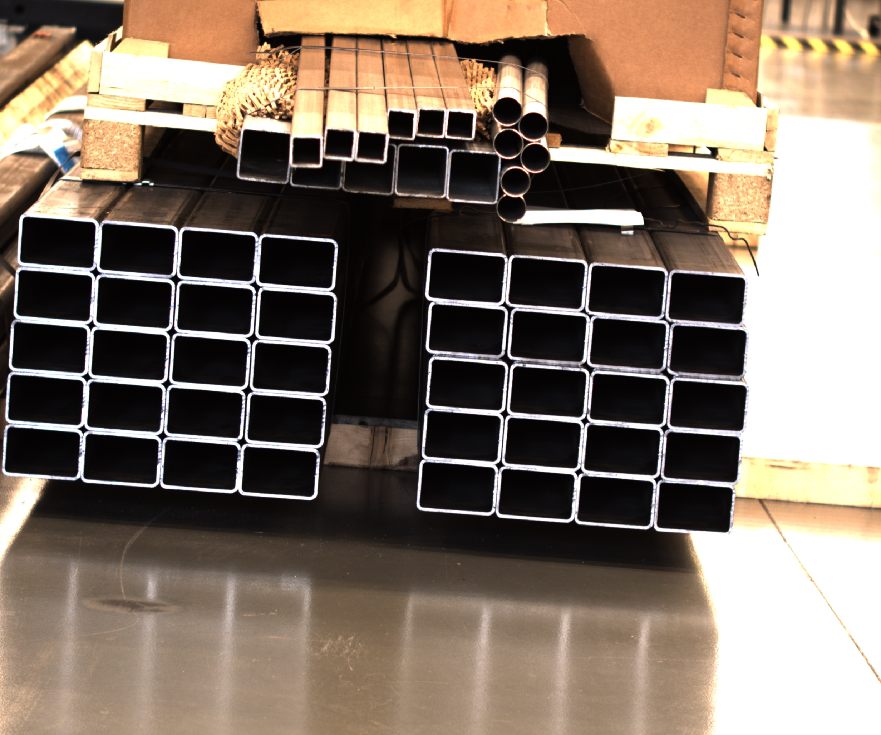
INFERENCE analysis 7

Slide 26
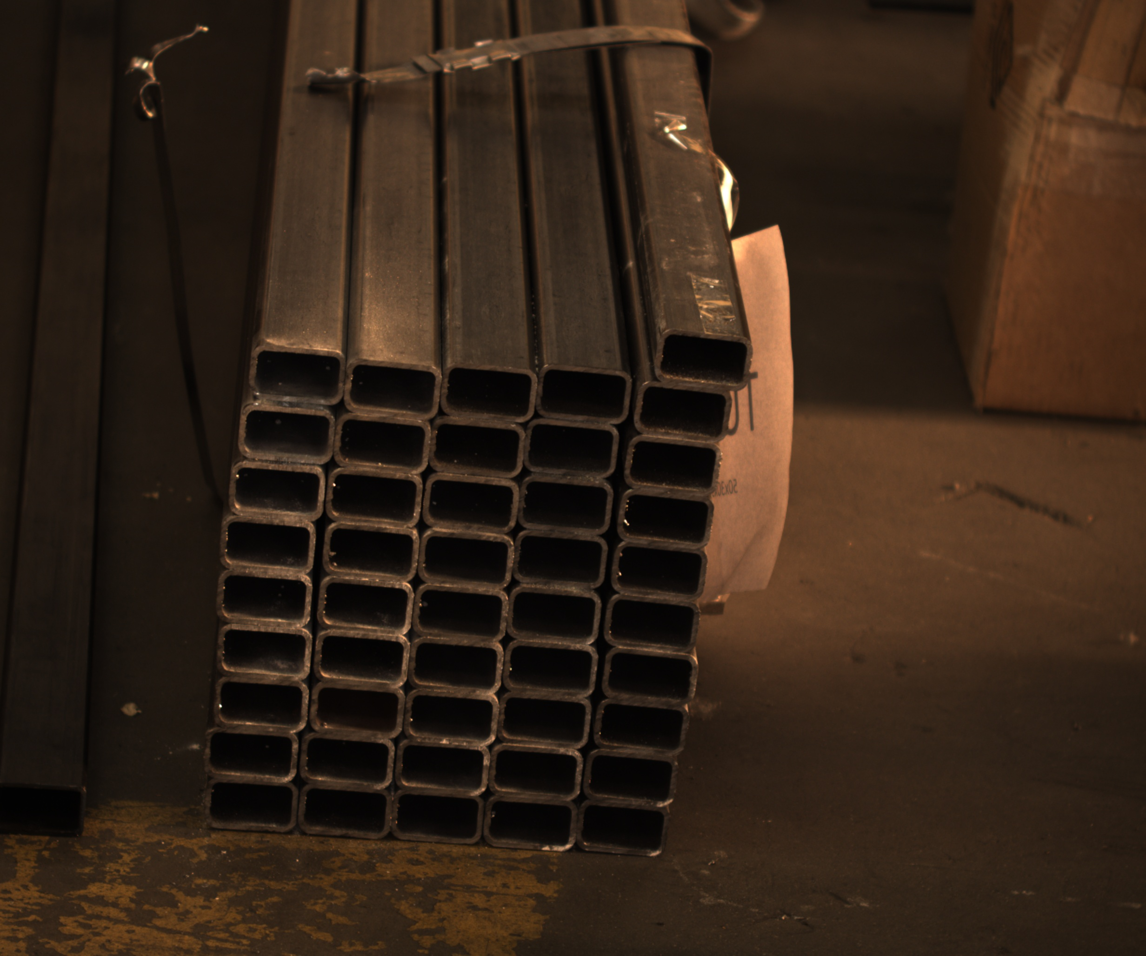
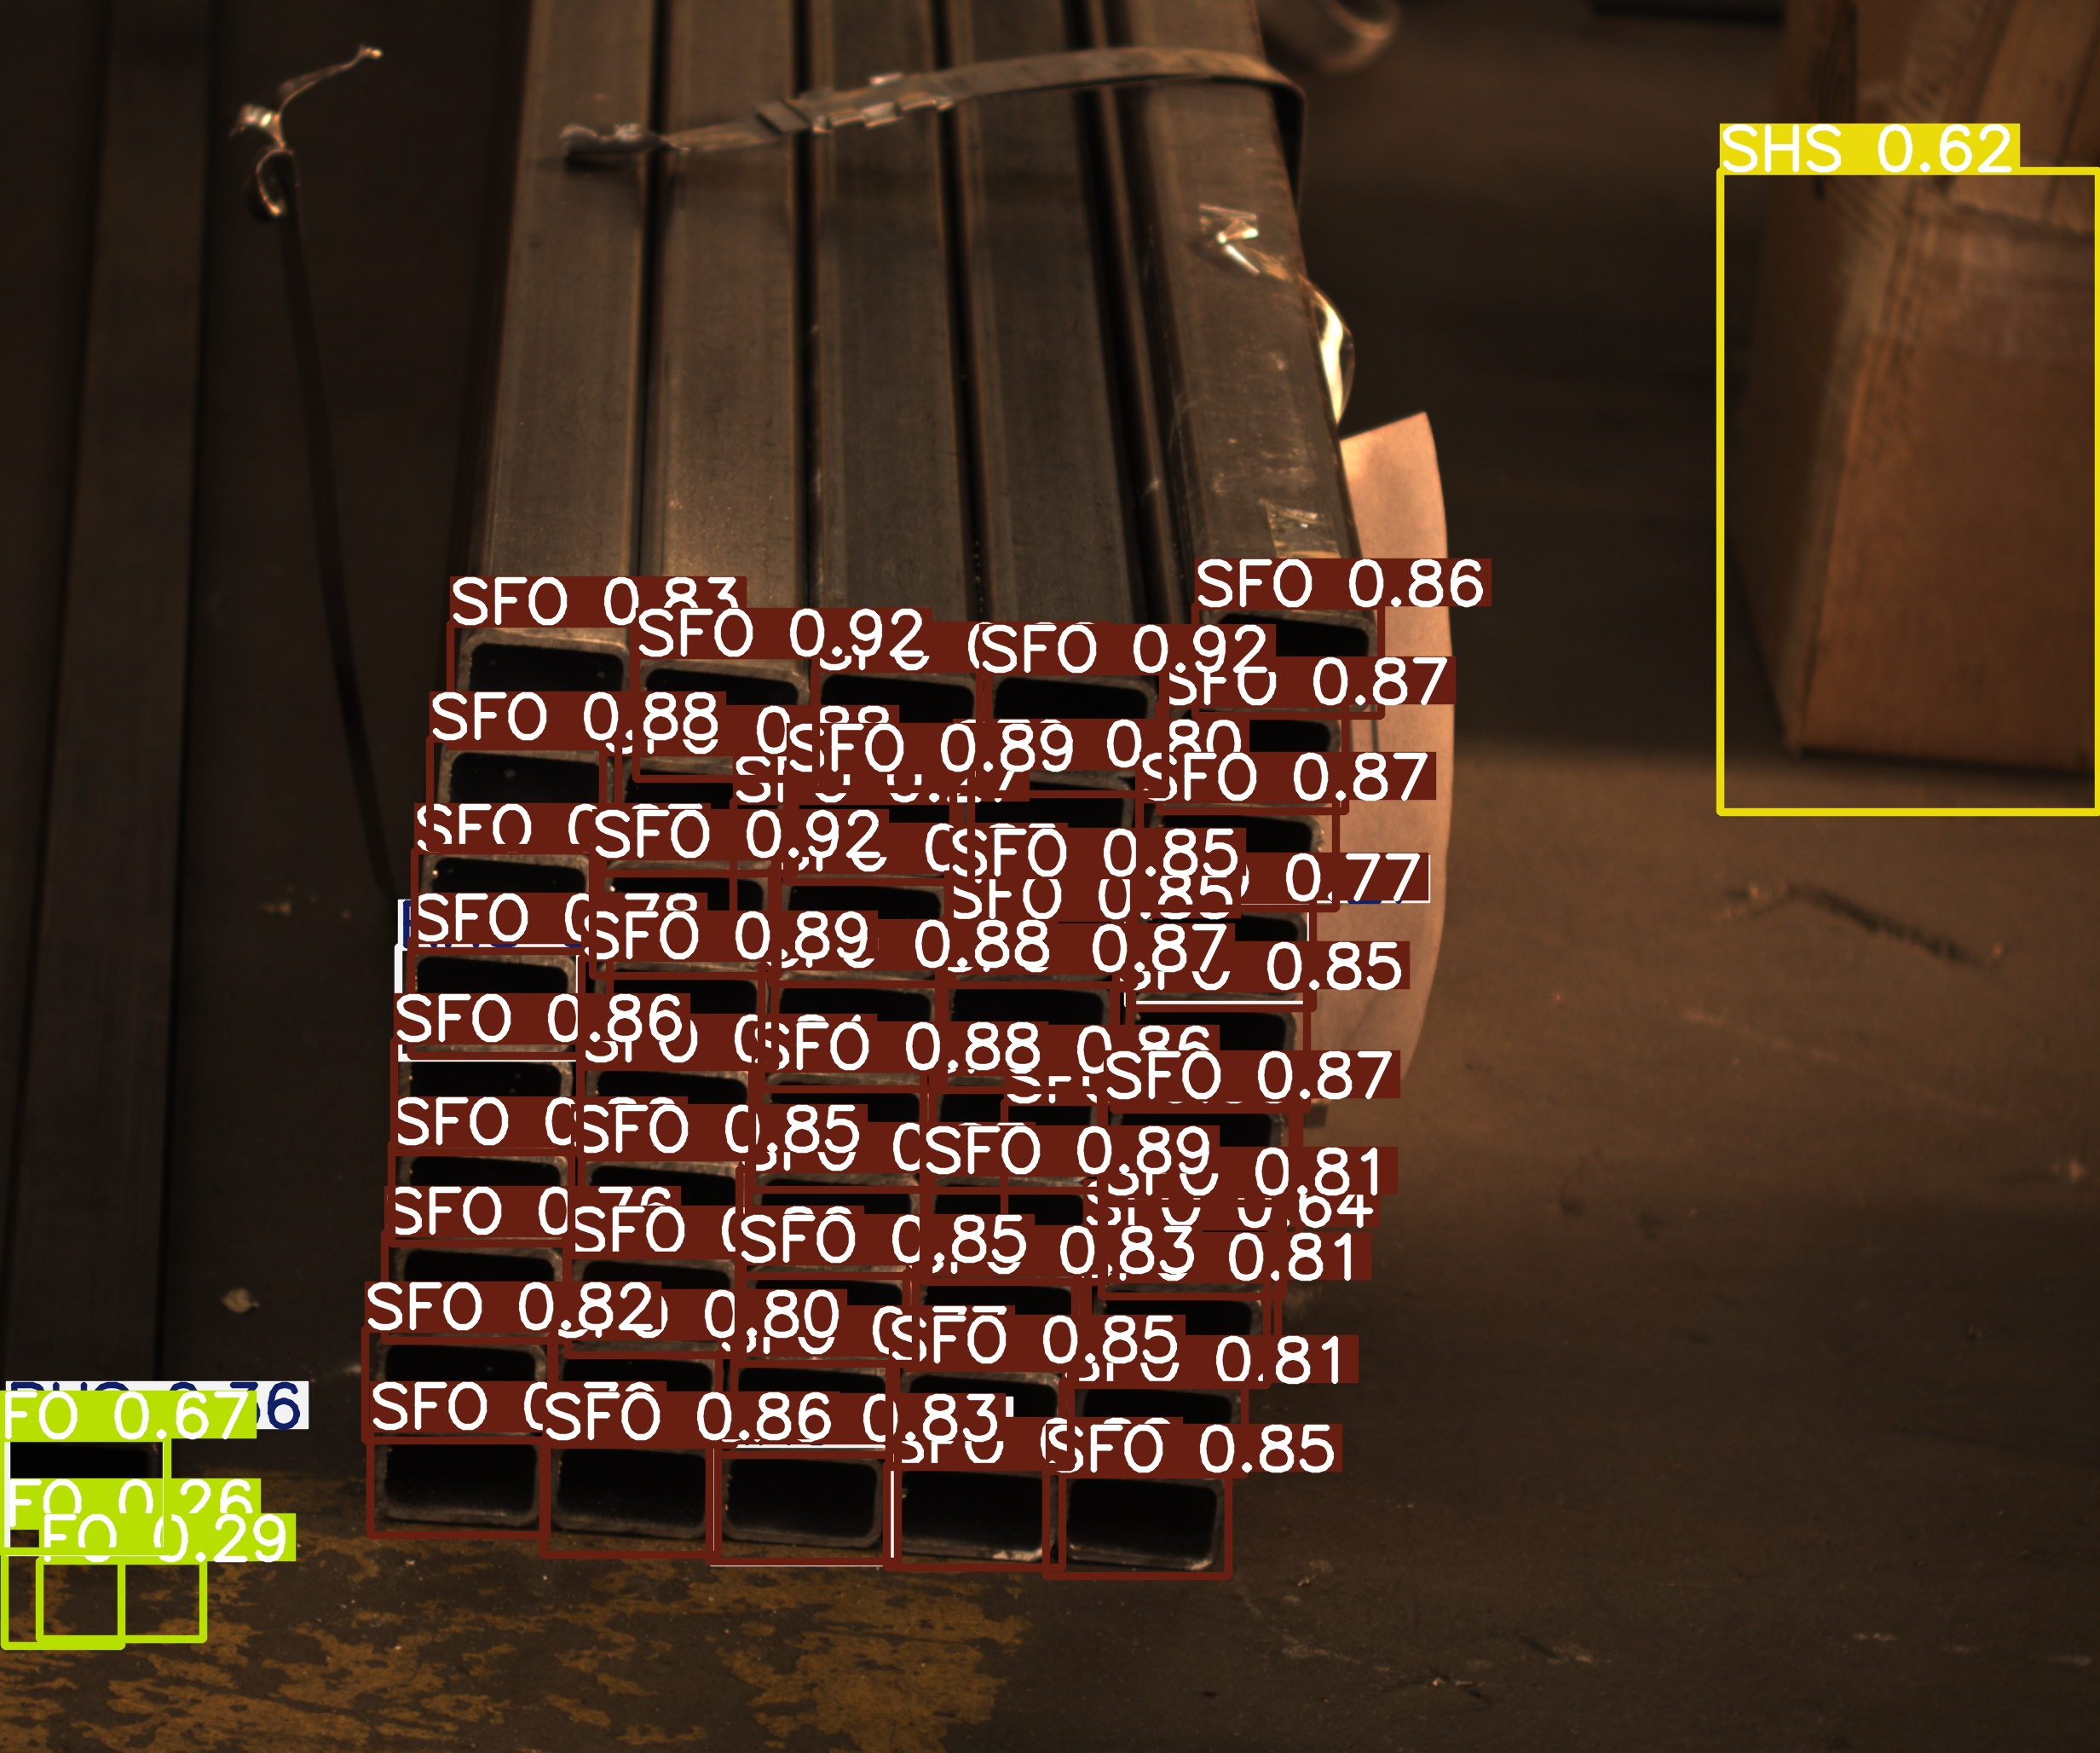
INFERENCE analysis 8

Slide 27
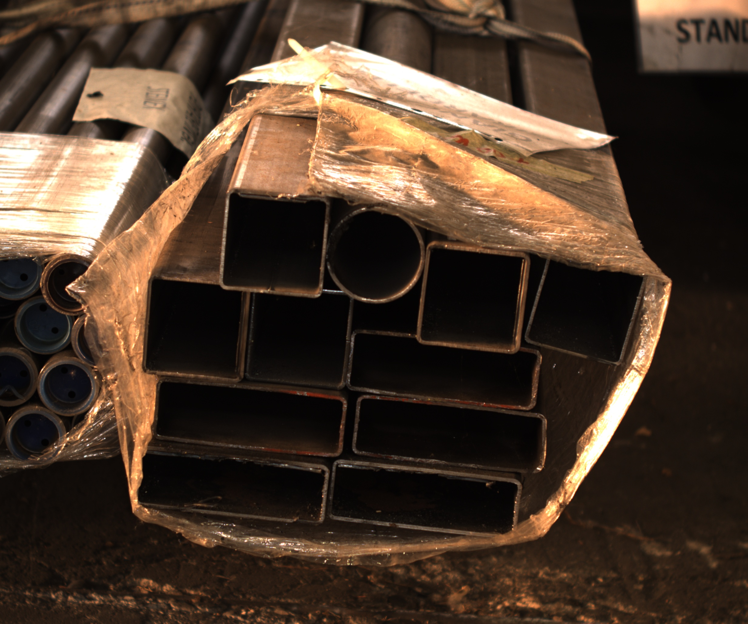
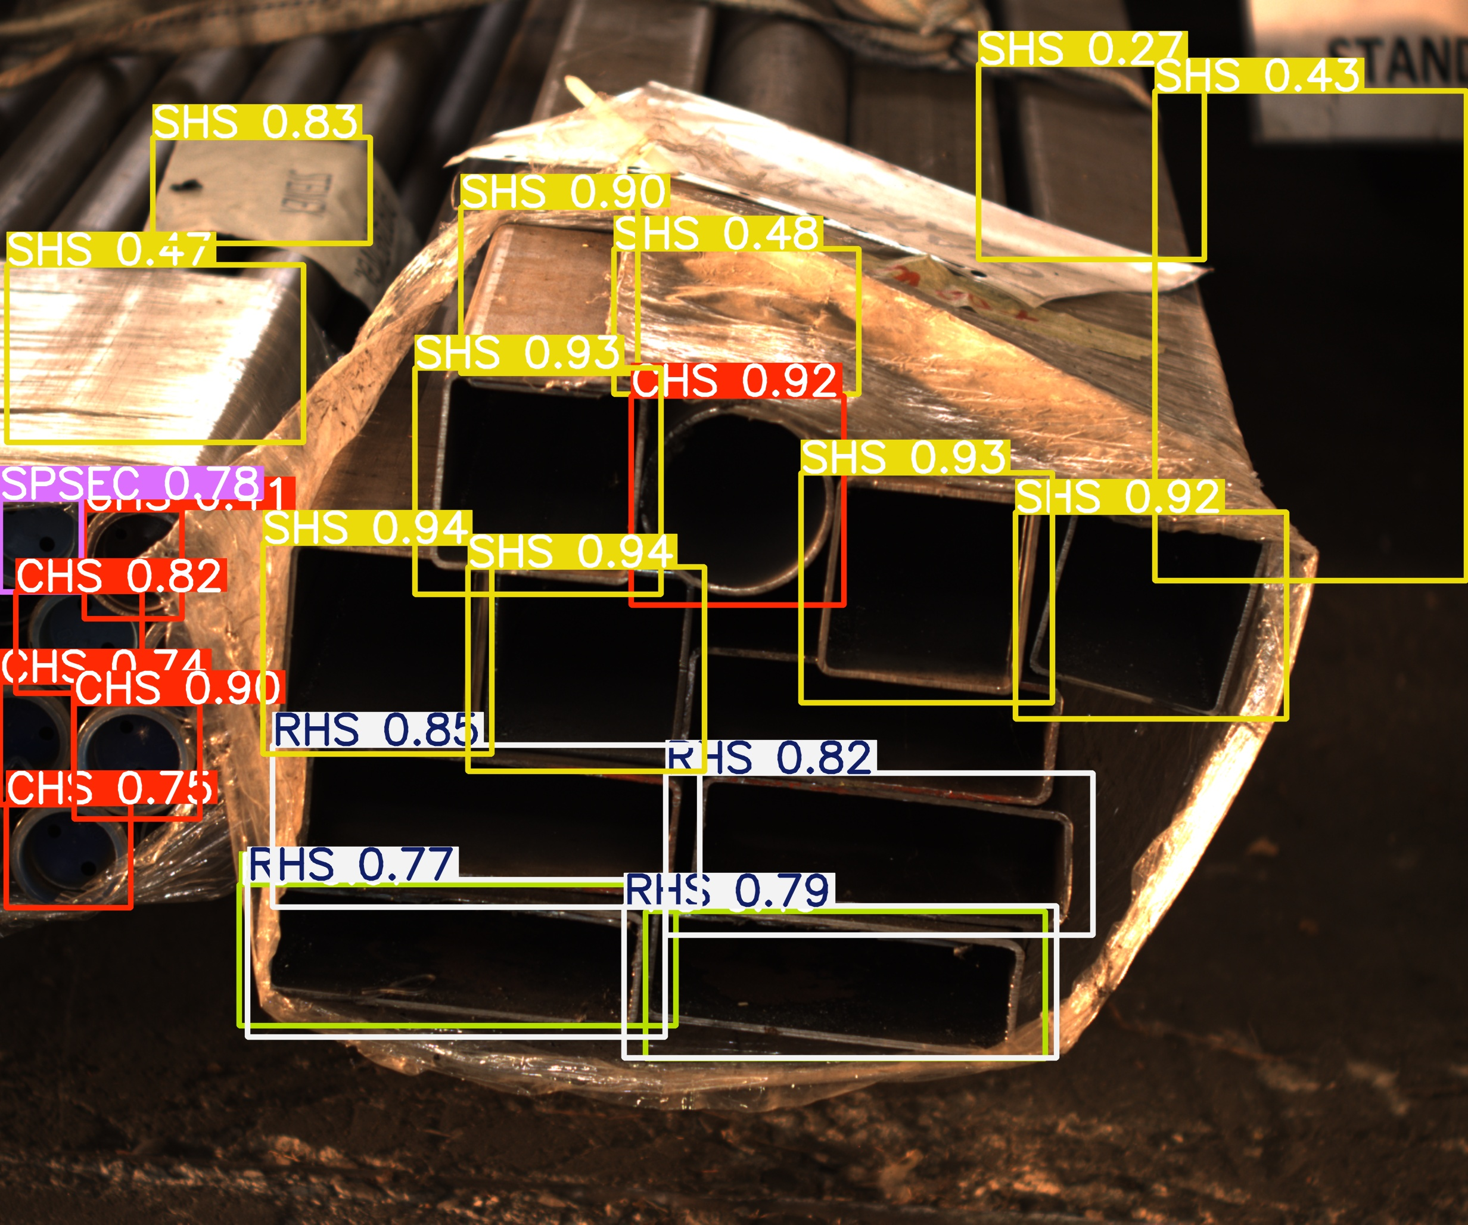
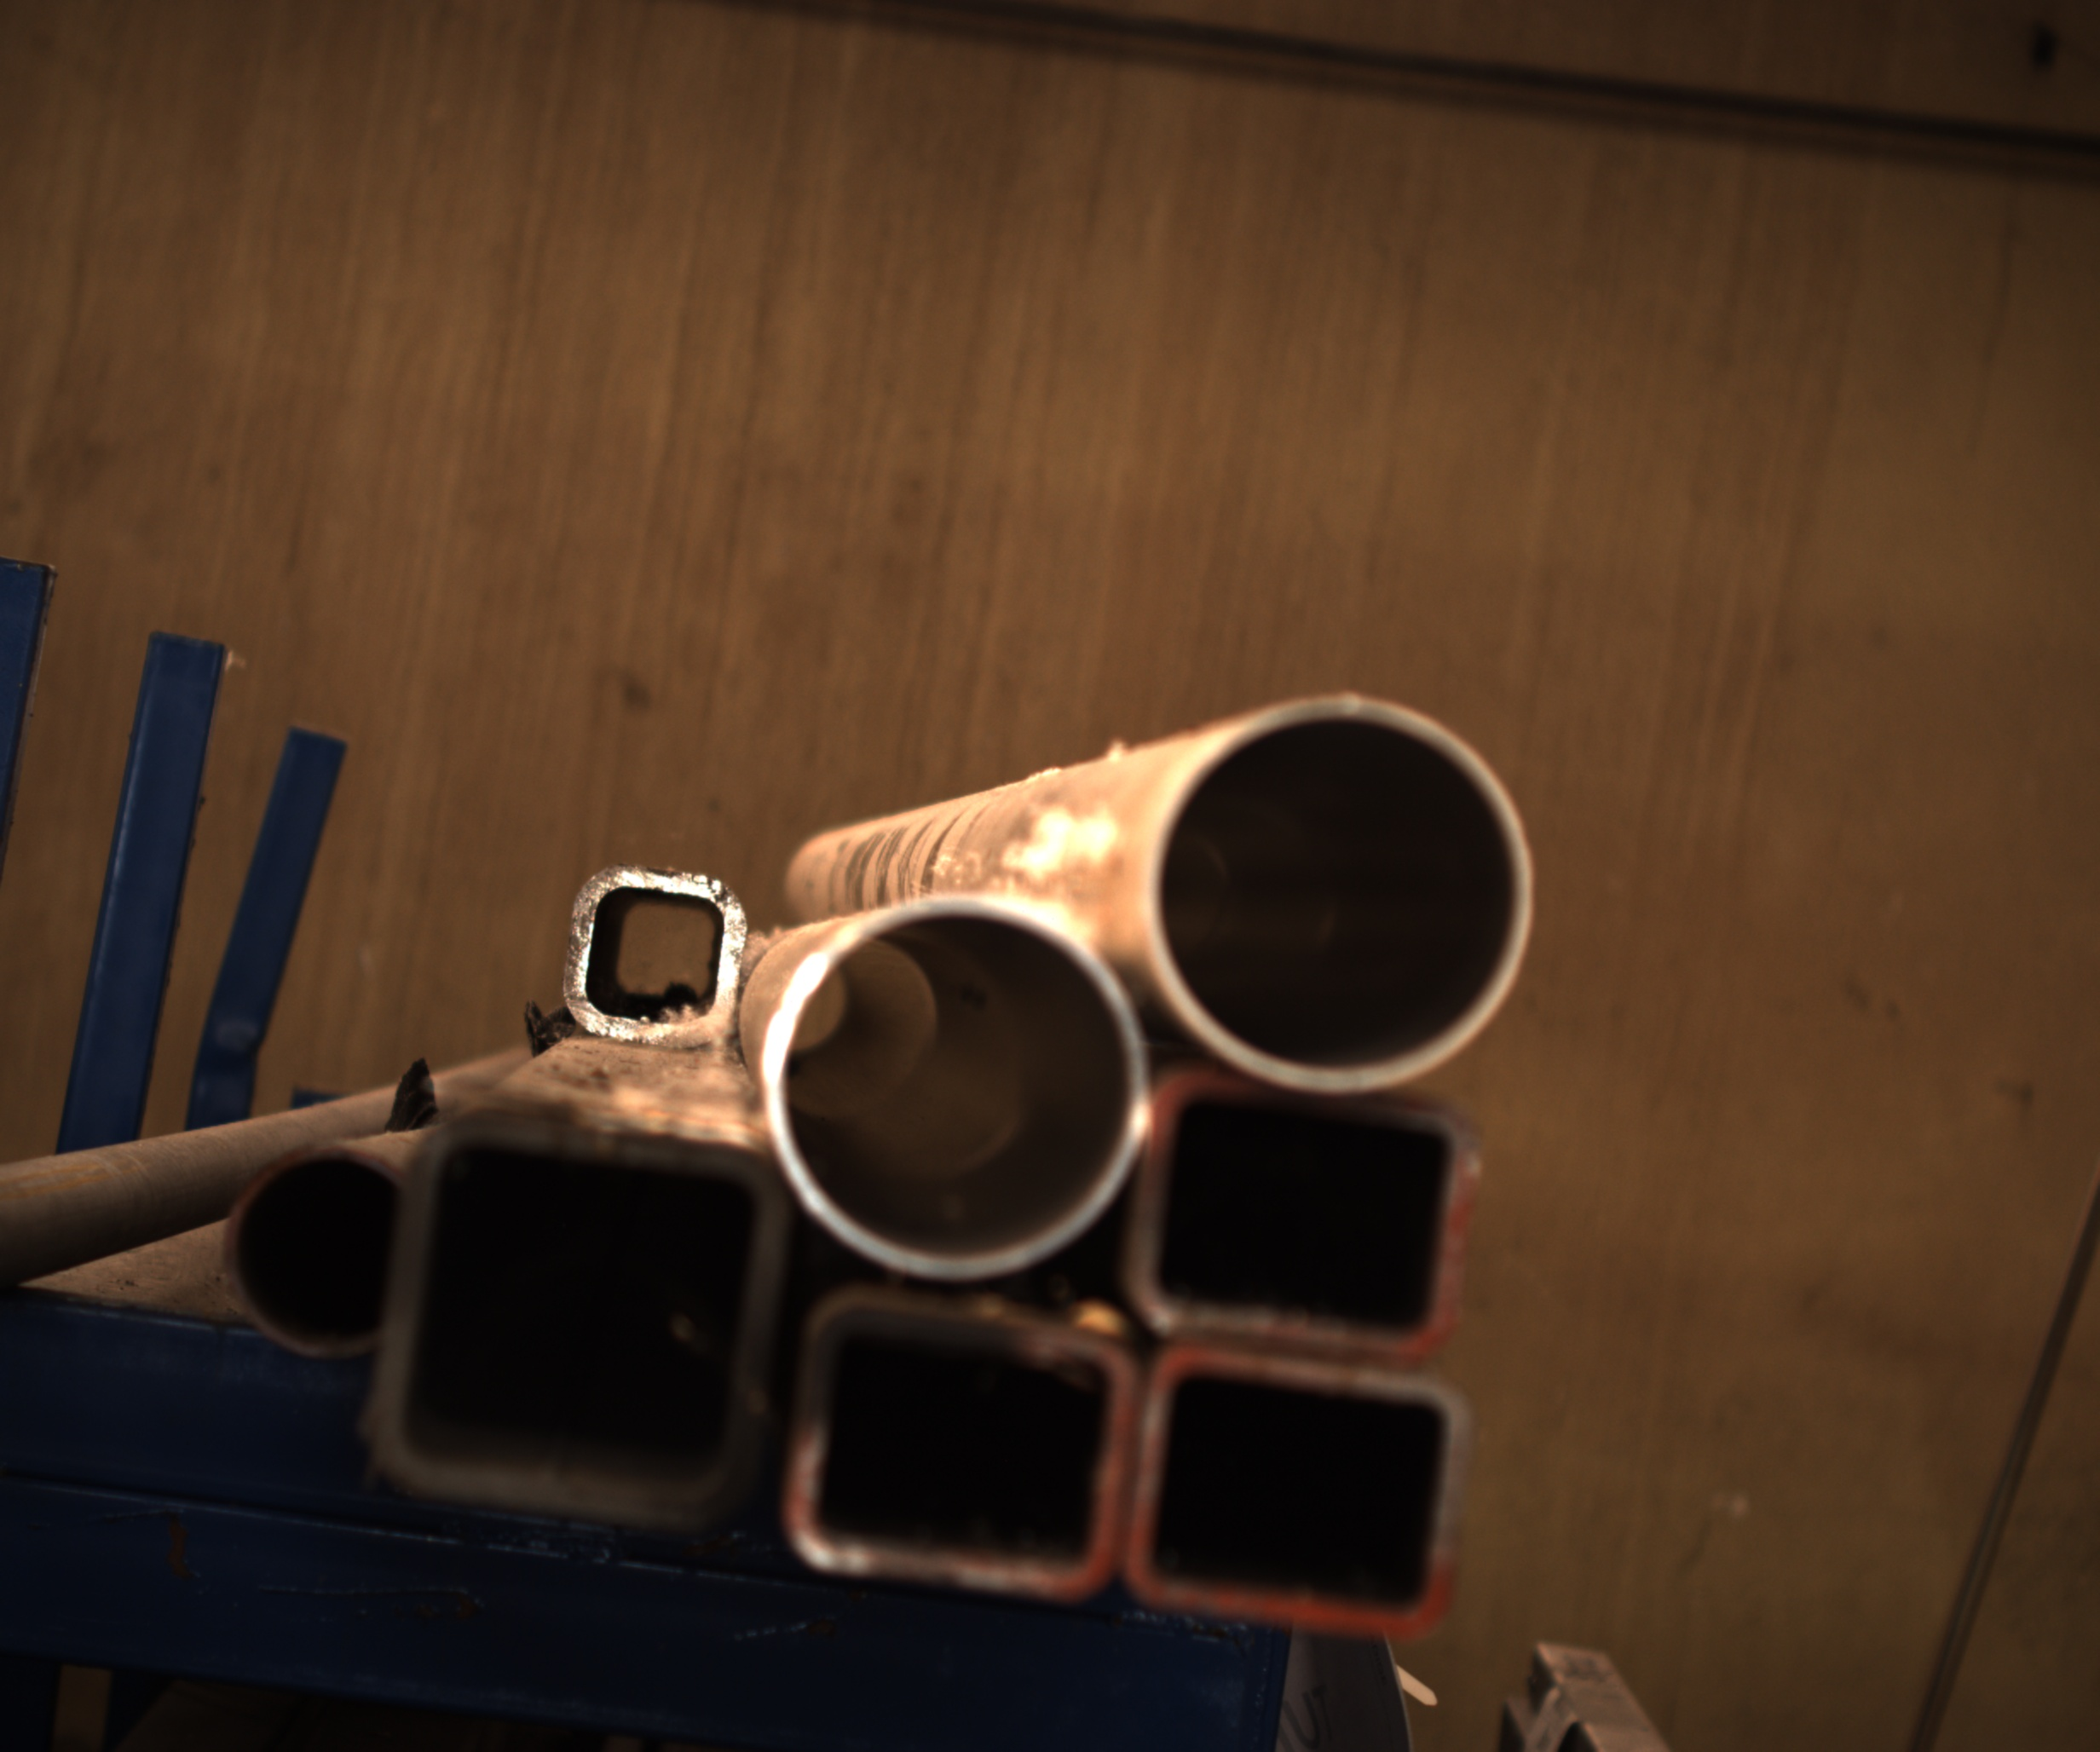
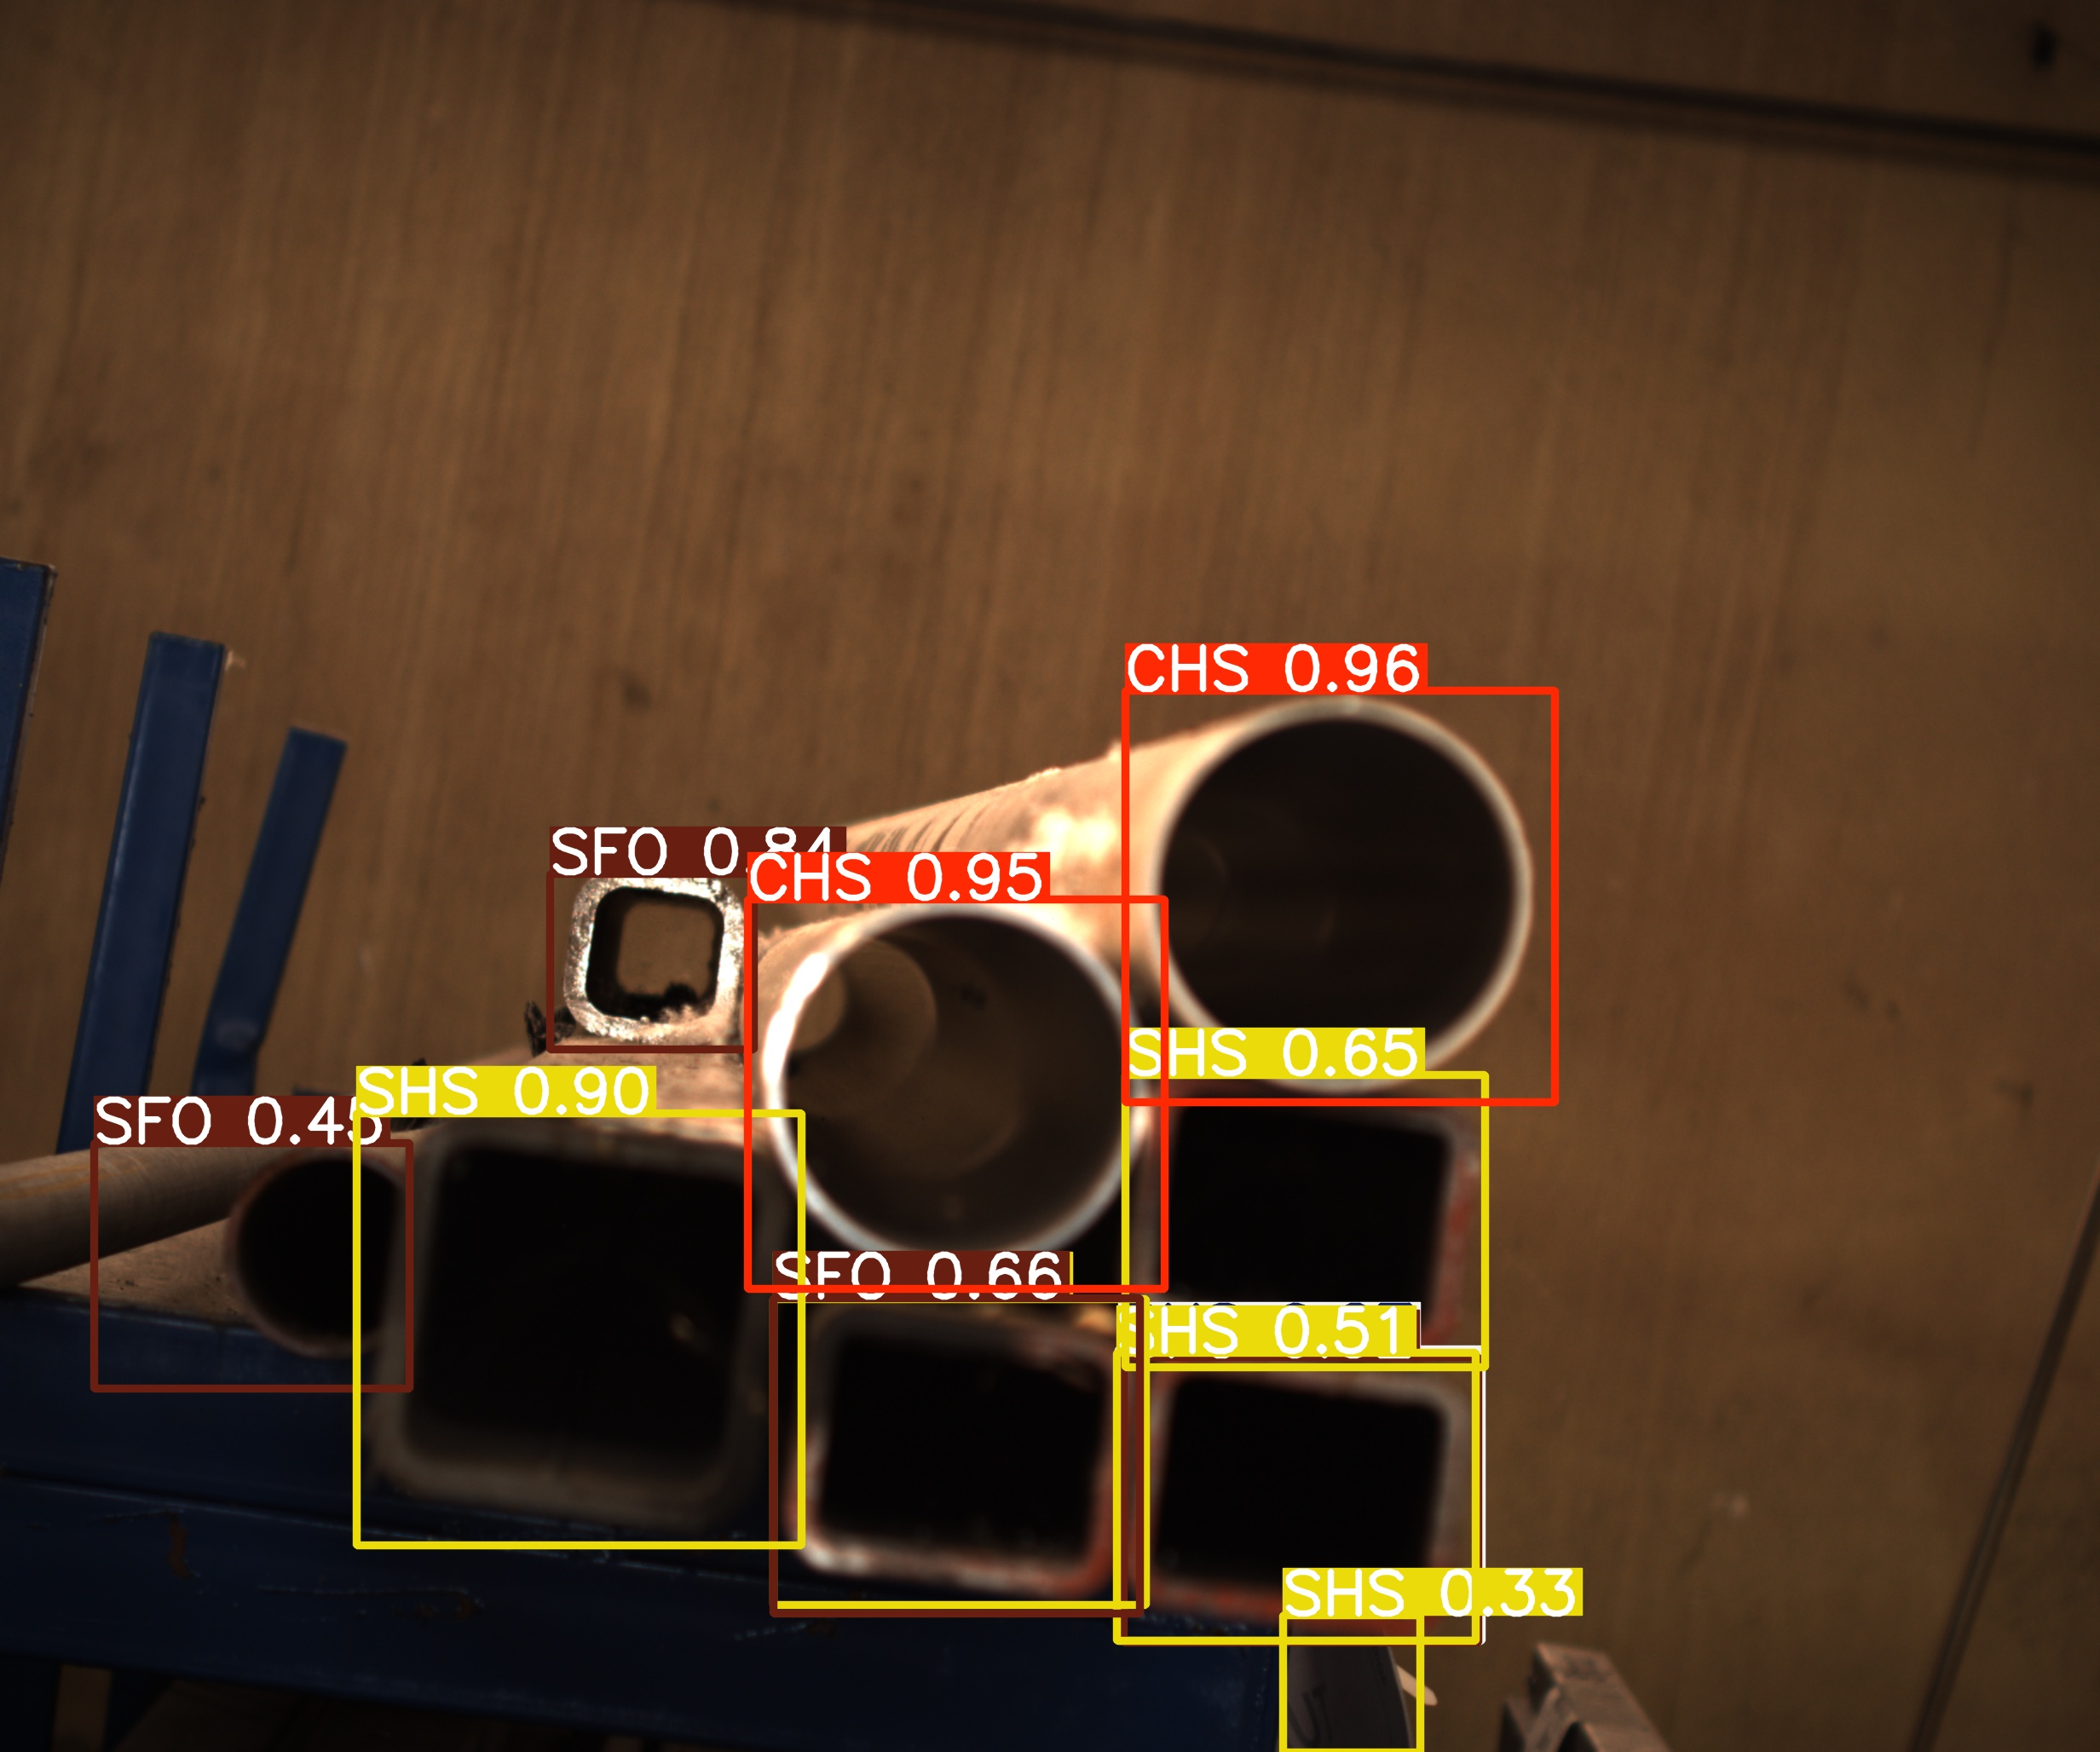

Slide 29
Factors affecting performance
Motion Stability: Ensuring that the camera is stable to avoid capturing motion blur.
Field of View: Selecting the appropriate field of view to adequately capture the scene.
Focal Length: Adjusting the focal length to achieve the desired depth of field and perspective.
Lighting Conditions: Providing proper lighting to enhance image clarity and detail.
Object Distance: Maintaining an optimal distance between the camera and the object to ensure accurate focus and detail.
Camera Angle: Positioning the camera at the correct angle to capture the most relevant details of the object.

